Slide 1
1.3 Midpoints And Segment Bisectors

Slide 2
What We Will Learn
Find segment lengths using midpoints and segment bisectors
Use midpoint formula
Use distance formula

Slide 3
Needed Vocab.
Midpoint: point that divides the segment into two congruent segments
Segment bisector: point, ray, line, line segment, or plane that intersects a segment at its midpoint.

Slide 4
Ex. 1 Finding Segment Lengths
VW bisects XY at point T and XT = 39.9 cm. Find XY
XY = 39.9 + 39.9
XY = 79.8

Slide 5
Ex. 2 Using Algebra with Segment Lengths
Point M is the midpoint of VW. Find length of VM
Solve for X
4x-1 = 3x+3
-3x -3x
x-1 = 3
+1 +1
x = 4
VM = 4(4)-1
VM = 16-1
VM = 15
MW = 15
So VW = 15+15
VW = 30

Slide 6

Your Practice
Find MQ
5x-3 = 11-2x
+2x +2x
7x-3 = 11
+3 +3
7x = 14
$\frac{7x}{7}= \frac{14}{7}$
x = 2
MQ = 11-2(2)
MQ = 11-4
MQ = 7

Slide 7
Ex. 3 Using Midpoint Part 1
Finding Midpoint
$\frac{x1+x2}{2} , \frac{y1+y2}{2}$
Find midpoint of line with endpoints (1,-3) and (4,2)
Stay consistent
Use x of point one first, use y of point one first also
$\frac{4+1}{2} , \frac{2+(−3)}{2}$
$\frac{5}{2} , \frac{−1}{2}$ leave as fraction

Slide 8
Your Practice
Find midpoint of segment with endpoints (3,-5) and (7,9)
$\frac{3+7}{2} , \frac{−5+9}{2}$
$\frac{10}{2} , \frac{4}{2}$
(5,2)

Slide 9
Ex.3 Using Midpoint Part 2
Using midpoint and one endpoint find other endpoint
G(5,-6) and M(4,3) M is midpoint
Use x and y coordinates of midpoint as what equal to
4 = $\frac{5+x}{2}$ and 3 = $\frac{−6+y}{2}$
(2)4 = ($\frac{5+x}{2}$)(2) and (2)3 = ($\frac{−6+y}{2}$)(2)
8 = 5+x and 6 = -6+y
-5 -5 +6 +6
3=x and 12=y
(3,12)

Slide 10
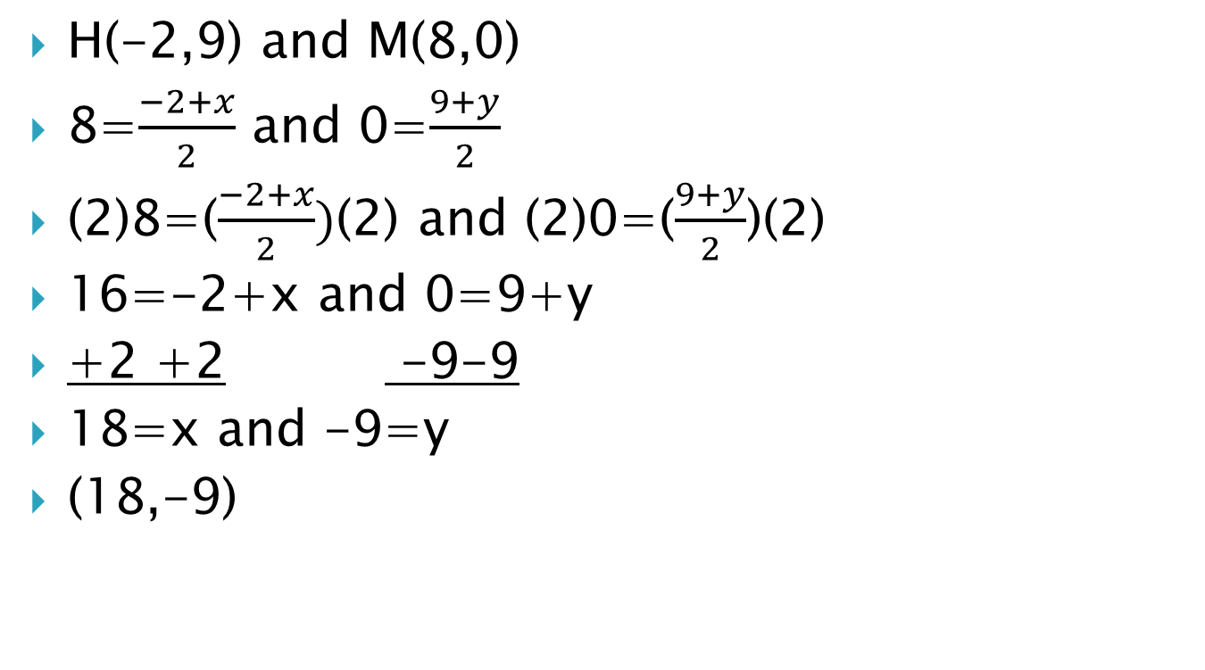
Ex.3 Part 2 cont.
H(-2,9) and M(8,0)
8=$\frac{−2+x}{2}$ and 0=$\frac{9+y}{2}$
(2)8=($\frac{−2+x}{2})$(2) and (2)0=($\frac{9+y}{2}$)(2)
16=-2+x and 0=9+y
+2 +2 -9-9
18=x and -9=y
(18,-9)

Slide 11
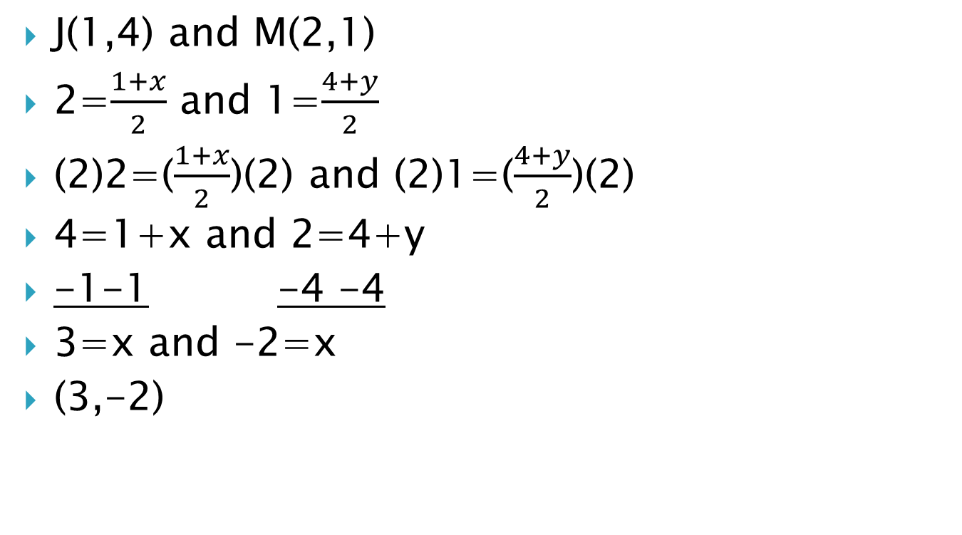
Your Practice
J(1,4) and M(2,1)
2=$\frac{1+x}{2}$ and 1=$\frac{4+y}{2}$
(2)2=($\frac{1+x}{2}$)(2) and (2)1=($\frac{4+y}{2}$)(2)
4=1+x and 2=4+y
-1-1 -4 -4
3=x and -2=x
(3,-2)

Slide 12
Ex. 4 Distance Formula
d=$\sqrt{\left(x2−x1\right)2+\left(y2−y1\right)2}$
Find distance of segment with endpoints R(2,3) and S(4,-1)
Stay consistent
d=$\sqrt{\left(3−\left(−1\right)\right)2+\left(2−4\right)2}$
d=$\sqrt{\left(4\right)2+\left(−2\right)2}$
d=$\sqrt{16+4}$
d=$\sqrt{20}$
d= 4.5

