Slide 1
1.3 Solving with Variables on Both Sides

Slide 2
What We Will Learn
Solve linear equations that have variables on both sides
Identify special solutions

Slide 3
Needed Vocab
Identity: equation that is true for all values
No solution: equation that is not true for any value

Slide 4

Ex. 1 Solve Variable on Both Sides
10 –4x = -9x
+9x +9x
10 +5x = 0
-10 -10
5x = -10
$\frac{5x}{5}= \frac{−10}{5}$
x = -2
5p – 9 = 2p + 12
-2p -2p
3p – 9 = 12
+9 +9
3p = 21
$\frac{3p}{3}= \frac{21}{3}$
p = 7
Move smaller variable to avoid negative variable

Slide 5
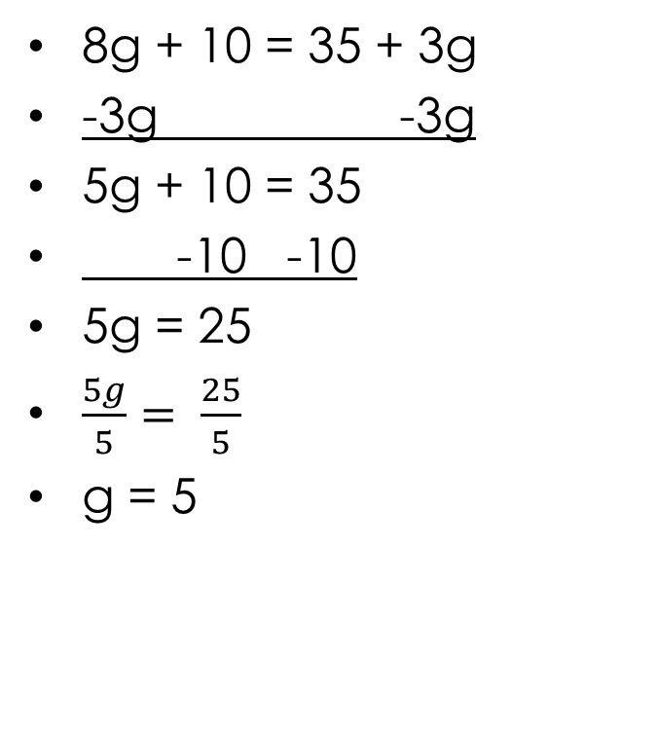
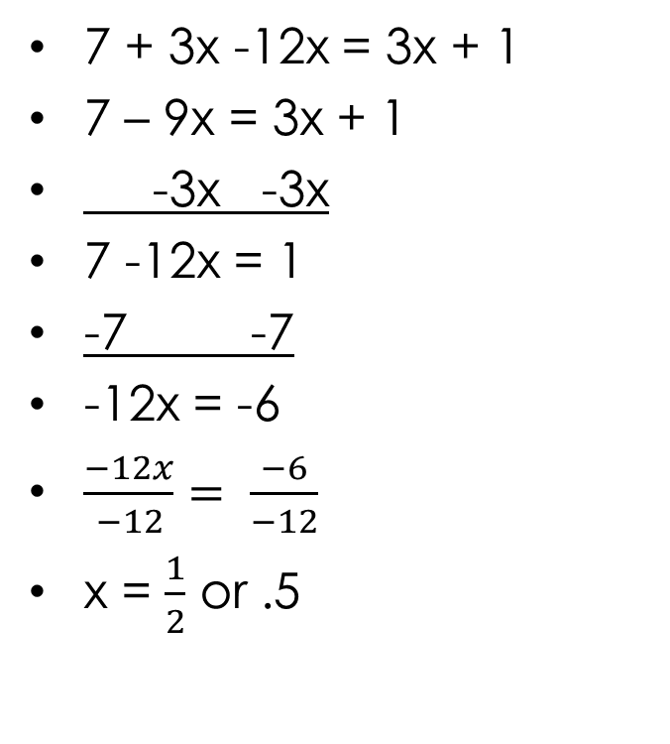
Your Practice
8g + 10 = 35 + 3g
-3g -3g
5g + 10 = 35
-10 -10
5g = 25
$\frac{5g}{5}= \frac{25}{5}$
g = 5
7 + 3x -12x = 3x + 1
7 – 9x = 3x + 1
-3x -3x
7 -12x = 1
-7 -7
-12x = -6
$\frac{−12x}{−12}= \frac{−6}{−12}$
x = $\frac{1}{2}$ or .5

Slide 6
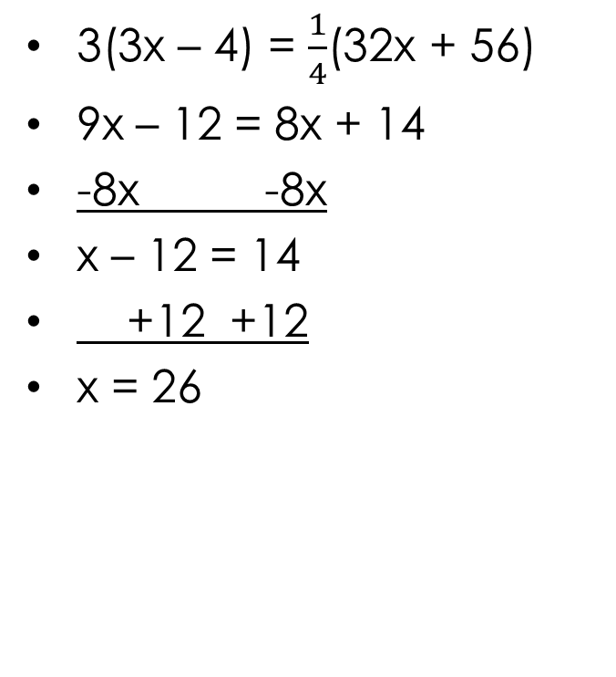
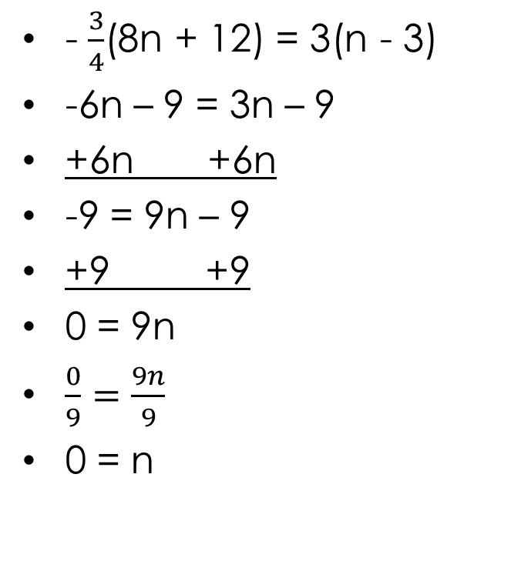
Ex. 2 Get Rid of ( )
3(3x – 4) = $\frac{1}{4}$(32x + 56)
9x – 12 = 8x + 14
-8x -8x
x – 12 = 14
+12 +12
x = 26
- $\frac{3}{4}$(8n + 12) = 3(n - 3)
-6n – 9 = 3n – 9
+6n +6n
-9 = 9n – 9
+9 +9
0 = 9n
$\frac{0}{9}=\frac{9n}{9}$
0 = n

Slide 7

Your Practice
$\frac{2}{3}$(3x + 9) = -2(2x + 6)
2x + 6 = -4x – 12
+4x +4x
6x + 6 = -12
-6 -6
6x = -18
$\frac{6x}{6}= \frac{−18}{6}$
x = -3

Slide 8
Ex. 3 Identifying Number of Solutions
3(5x + 2) = 15x
15x + 6 = 15x
-15x -15x
6 = 0
No Solution
-2(4y + 1) = -8y – 2
-8y – 2 = -8y – 2
+8y +8y
-2 = -2
Identity
Infinite many solutions

Slide 9
Your Practice
Solve for x and write no solution or infinite solutions where appropriate
3(2a – 2) = 2 (3a – 3)
6a – 6 = 6a – 6
-6a -6a
-6 = -6
Infinite many solutions

Slide 10
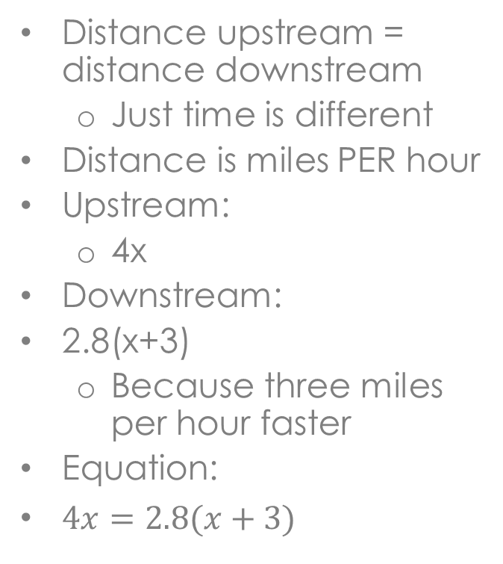
Ex. 4 Story Problems
A boat leaves New Orleans and travels upstream on the Mississippi River for 4 hours. The return trip takes only 2.8 hours because the boat travels 3 miles per hour faster downstream due to current. How far does the boat travel upstream?
Distance upstream = distance downstream
Just time is different
Distance is miles PER hour
Upstream:
4x
Downstream:
2.8(x+3)
Because three miles per hour faster
Equation:
$4x=2.8(x+3)$

