Slide 1
1.4 Perimeter and Area

Slide 2
What We Will Learn
Classify Polygons
Find perimeter and area of polygons in the coordinate plane

Slide 3
Needed Vocab
Polygon: figure with three or more sides
Convex: no vertex is inside the polygon
Concave: vertex or vertices are inside the polygon

Slide 4
Ex. 1 Classifying Polygons
Sides | Polygon
3 | Triangle
4 | Quadrilateral
5 | Pentagon
6 | Hexagon
7 | Heptagon
8 | Octagon
9 | Nonagon
10 | Decagon
12 | Dodecagon
N | n-gon

Slide 5
Classifying Continued
Name using concave or convex first
Concave: a vertex or some vertices lie inside the polygon
Convex: all vertices are on outside of polygon
Name:
Convex hexagon
Concave dodecagon

Slide 6
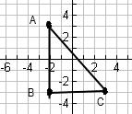
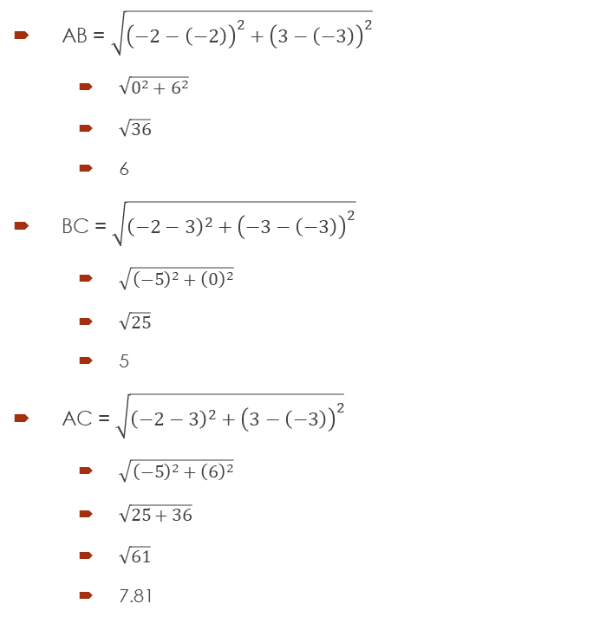
Ex. 2 Finding Perimeter
AB = $\sqrt{{\left(−2−\left(−2\right)\right)}^{2}+{\left(3−\left(−3\right)\right)}^{2}}$
$\sqrt{0^{2}+6^{2}}$
$\sqrt{36}$
6
BC = $\sqrt{{\left(−2−3\right)}^{2}+{\left(−3−\left(−3\right)\right)}^{2}}$
$\sqrt{{\left(−5\right)}^{2}+{\left(0\right)}^{2}}$
$\sqrt{25}$
5
AC = $\sqrt{{\left(−2−3\right)}^{2}+{\left(3−\left(−3\right)\right)}^{2}}$
$\sqrt{{\left(−5\right)}^{2}+{\left(6\right)}^{2}}$
$\sqrt{25+36}$
$\sqrt{61}$
7.81
Use distance formula to find all side lengths
$\sqrt{{\left(x_{2}−x_{1}\right)}^{2}+{\left(y_{2}−y_{1}\right)}^{2}}$
Then add up all sides
7.81 + 5 + 6
18.81

Slide 7
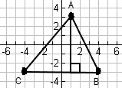
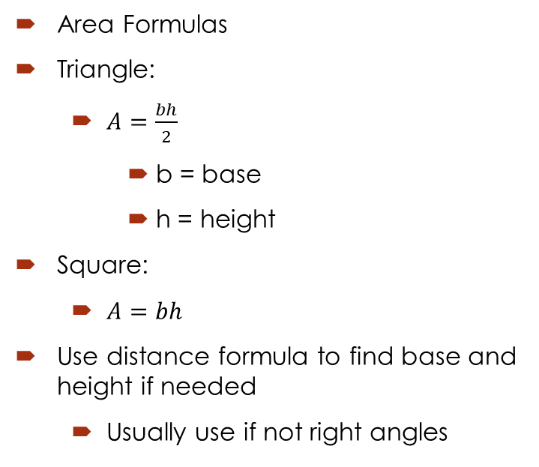
Ex. 3 Finding Area
Area Formulas
Triangle:
$A=\frac{bh}{2}$
b = base
h = height
Square:
$A=bh$
Use distance formula to find base and height if needed
Usually use if not right angles
Find base and height
b = 8, h = 6
$A=\frac{8∗6}{2}$
$A=\frac{48}{2}$
$A=24$

