Slide 1
1.6 Angle Pairs

Slide 2
What We will learn
Identify complementary and supplementary angles
Identify linear pairs and vertical angles

Slide 3
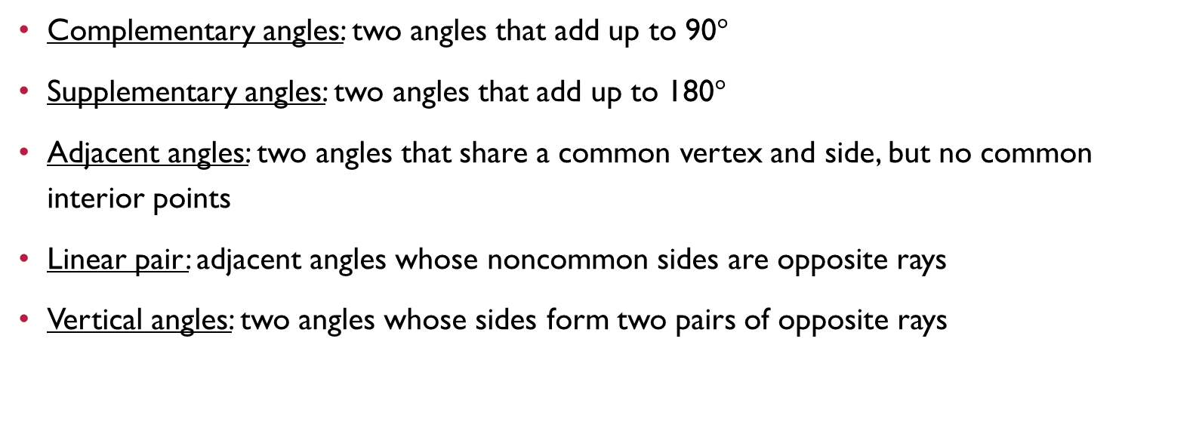
Needed vocab
Complementary angles: two angles that add up to 90$°$
Supplementary angles: two angles that add up to 180$°$
Adjacent angles: two angles that share a common vertex and side, but no common interior points
Linear pair: adjacent angles whose noncommon sides are opposite rays
Vertical angles: two angles whose sides form two pairs of opposite rays

Slide 4
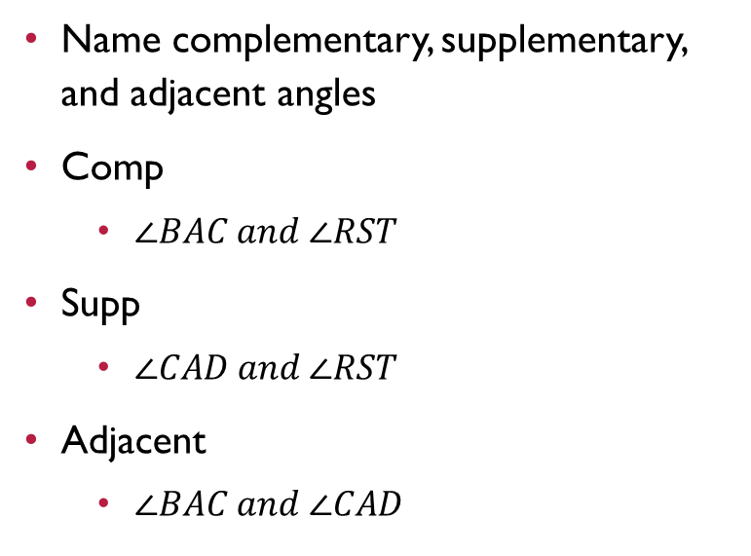
Ex. 1 identifying angle pairs
Name complementary, supplementary, and adjacent angles
Comp
$∠BAC and ∠RST$
Supp
$∠CAD and ∠RST$
Adjacent
$∠BAC and ∠CAD$
D
C
127
A
37
R
B
S
53
T

Slide 5

Ex. 2 finding angle measures
$∠$1 is a complement of $∠$2. $∠$1 is 62$°$. Find m$∠$2.
90 – 62 = m$∠2$
28 = m$∠2$
$∠3$ is a supplement of $∠4$. m$∠4$ is 47$°$. Find m$∠3$.
180 – 47=
133$°$

Slide 6
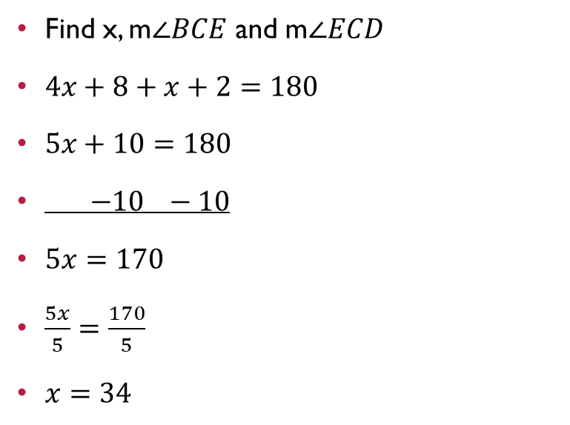
Ex. 3 modeling
Find x, m$∠BCE$ and m$∠ECD$
$4x+8+x+2=180$
$5x+10=180$
$−10 −10$
$5x=170$
$\frac{5x}{5}=\frac{170}{5}$
$x=34$
Plug in x to find angles
$m∠BCE$ is $4\left(34\right)+8$
136+8
144
$m∠ECD$ is 34+2
36
E
X + 2
D
4x + 8
C
B

Slide 7

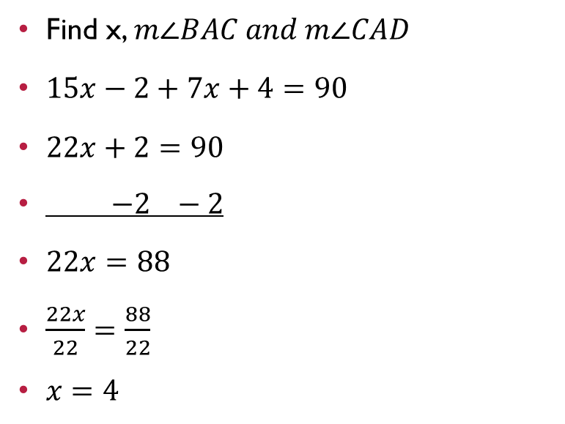
Your Practice
Find x, $m∠BAC and m∠CAD$
$15x−2+7x+4=90$
$22x+2=90$
$−2 −2$
$22x=88$
$\frac{22x}{22}=\frac{88}{22}$
$x=4$
$m∠BAC=15\left(4\right)−2$
60 – 2
58
$m∠CAD=7\left(4\right)+4$
28 + 4
32
B
C
15x - 2
7x + 4
A
D

Slide 8
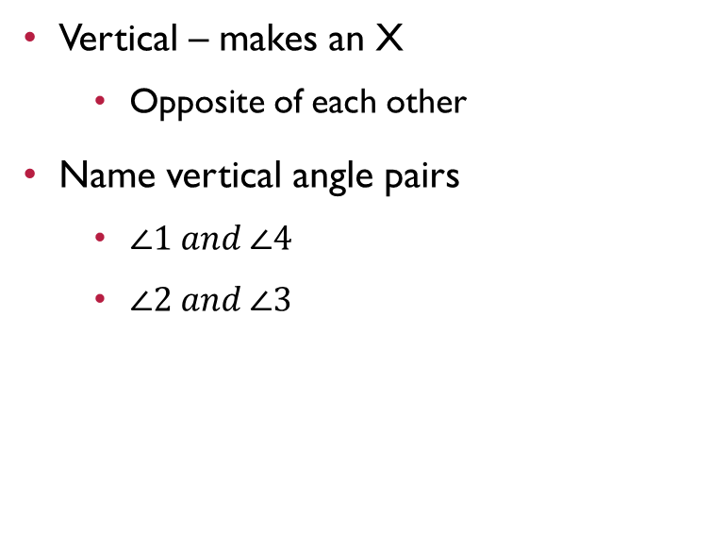
Ex. 4 linear pairs and vertical angles
Linear – make a straight line
Name all linear pairs
$∠1 and ∠2$
$∠3 and ∠4$
Vertical – makes an X
Opposite of each other
Name vertical angle pairs
$∠1 and ∠4$
$∠2 and ∠3$
1
2
3
4

