Slide 1
10.1 Lines and Segments with Circles

Slide 2
What We Will Learn
Identify special segments
Draw and identify tangents
Use properties of tangents

Slide 3
Needed Vocab
Circle: set of all points in a plane that are equidistant from the center
Center: middle of a circle
Radius: segment from center to point on a circle
Diameter: segment from side to side of a circle through the center
Chord: segment from side to side of a circle
Secant: line that intersects a circle in two points
Tangent: line that hits circle in exactly one point
Point of Tangency: where tangent line hits a circle
Tangent circles: circles that touch at exactly one point
Concentric circles: circles with a common center
Common tangent: line or segment that is tangent to two circles

Slide 4
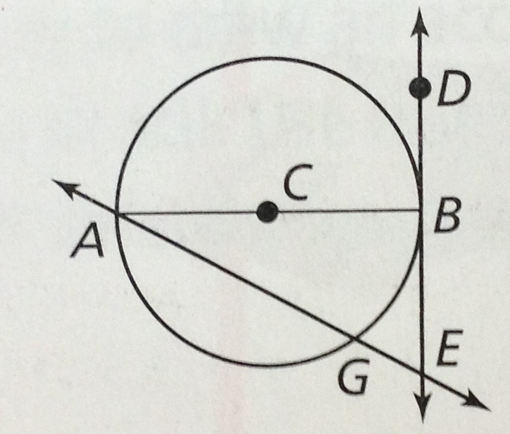
Ex. 1 Identifying Special Segments
Identify each line or segment
A. $\overline{AC}$
radius
B. $\overline{AB}$
diameter
C. $\vec{DE}$
tangent
D. $\vec{AE}$
secant

Slide 5
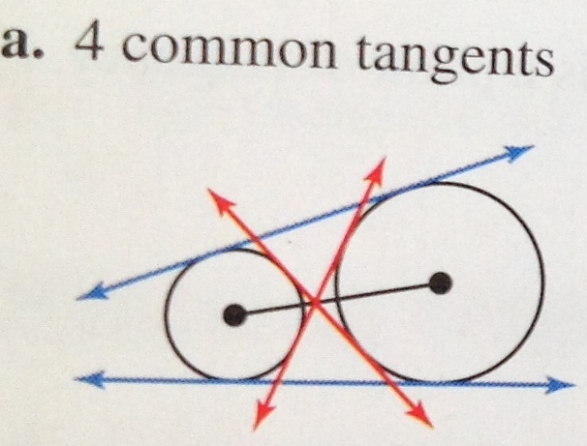
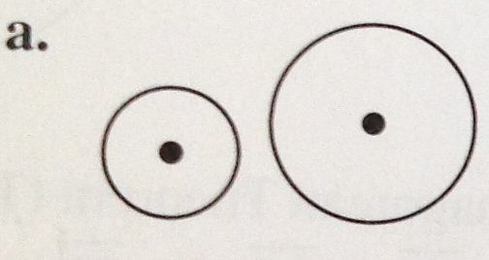
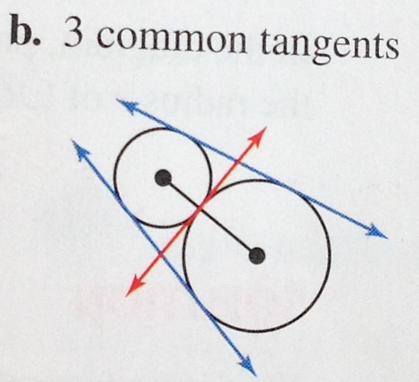
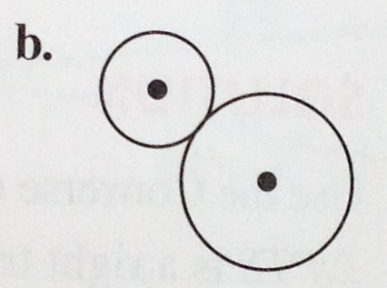
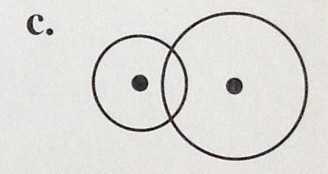
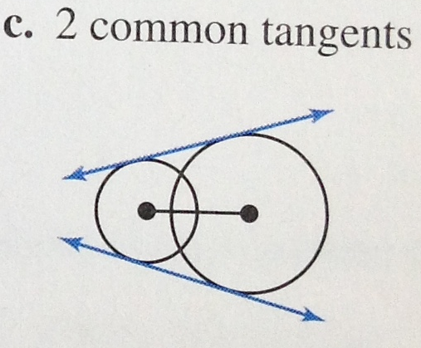
Ex. 2 Drawing and Identifying Common Tangents
Tell how many common tangents
A.
B.
C.
A.
B.
C.

Slide 6
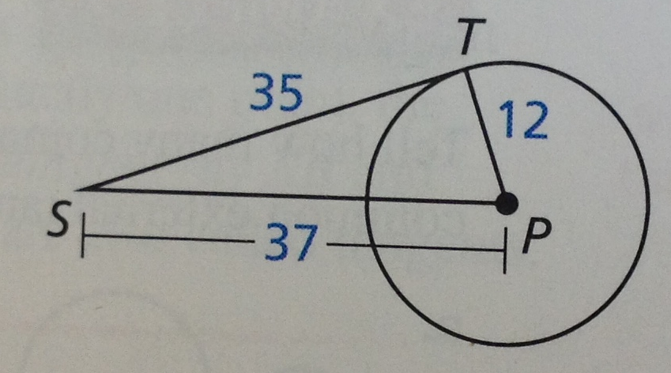
Ex. 3 Verifying a Tangent
Use Pythagorean Thm.
Remember c is longest side
$a^{2}+b^{2}=c^{2}$
${12}^{2}+{35}^{2}={37}^{2}$
$144+1225=1369$
$1369=1369$

Slide 7
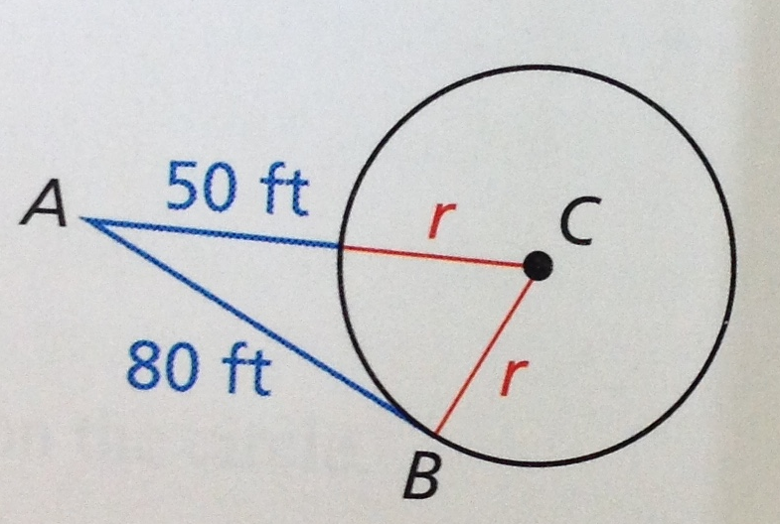
Ex. 4 Finding a Radius
Use Pythagorean Thm.
$$r^{2}+{80}^{2}={\left(r+50\right)}^{2}$$
$$r^{2}+6400=r^{2}+100r+2500$$
$$−r^{2} −r^{2}$$
$$6400=100r+2500$$
$$−2500 −2500$$
$$3900=100r$$
$$\frac{3900}{100}=\frac{100r}{100}$$
$$39=r$$

Slide 8
Your Practice
Find r
$r^{2}+{36}^{2}={\left(r+24\right)}^{2}$
$r^{2}+1296=r^{2}+48r+576$
$1296=48r+576$
$−576 −576$
$720=48r$
$\frac{720}{48}=\frac{48r}{48}$
$15=r$

Slide 9
Ex. 5 Using Properties of Tangents
Find x
$28=3x+4$
$−4 −4$
$24=3x$
$\frac{24}{3}=\frac{3x}{3}$
$8=x$

