Slide 1
10.7 Circles in coordinate plane

Slide 2
What we will learn
Write and graph equations of circles

Slide 3

Needed vocab
Equation of a circle: ${\left(x−h\right)}^{2}+{\left(y−k\right)}^{2}=r^{2}$
  where (h,k) is center of the circle

Slide 4
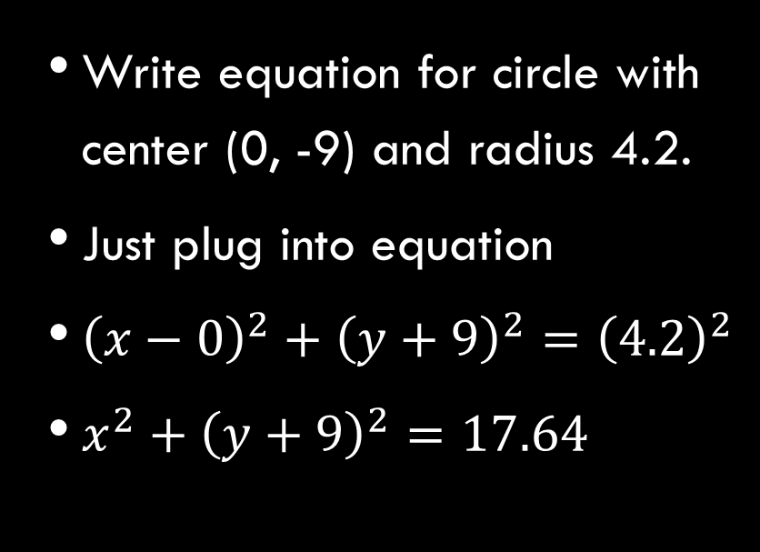
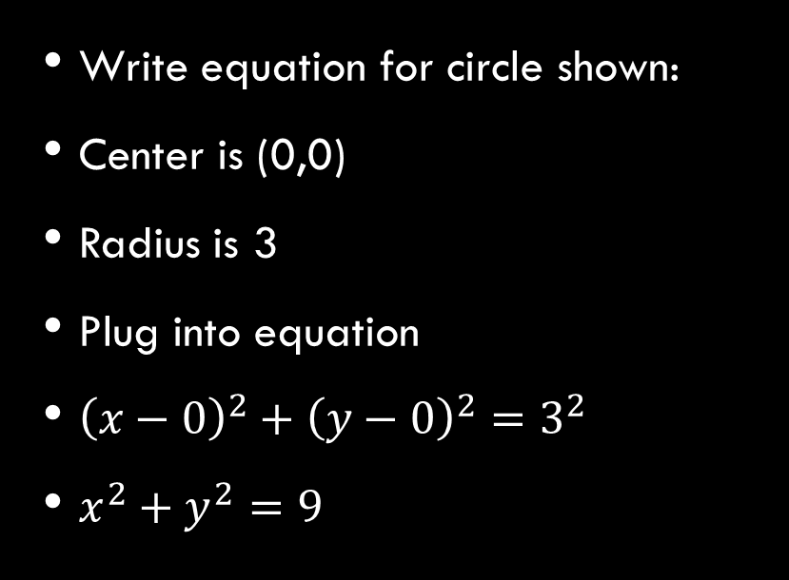
Ex. 1 Writing equation
Write equation for circle shown:
Center is (0,0)
Radius is 3
Plug into equation
${\left(x−0\right)}^{2}+{\left(y−0\right)}^{2}=3^{2}$
$x^{2}+y^{2}=9$
Write equation for circle with center (0, -9) and radius 4.2.
Just plug into equation
${\left(x−0\right)}^{2}+{\left(y+9\right)}^{2}={\left(4.2\right)}^{2}$
$x^{2}+{\left(y+9\right)}^{2}=17.64$

Slide 5
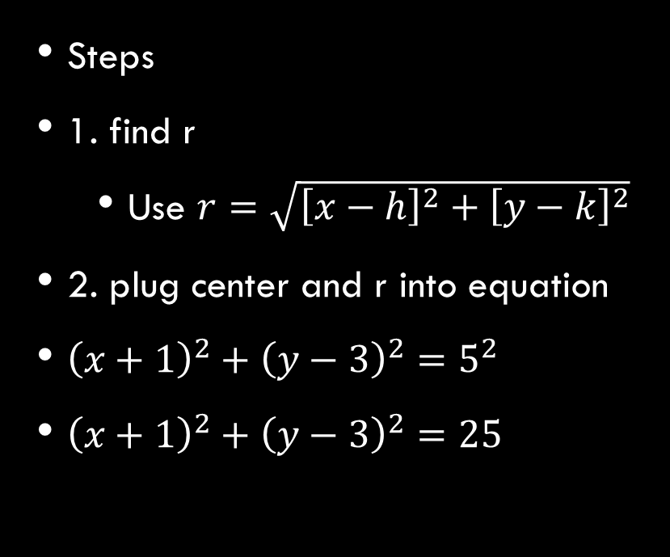
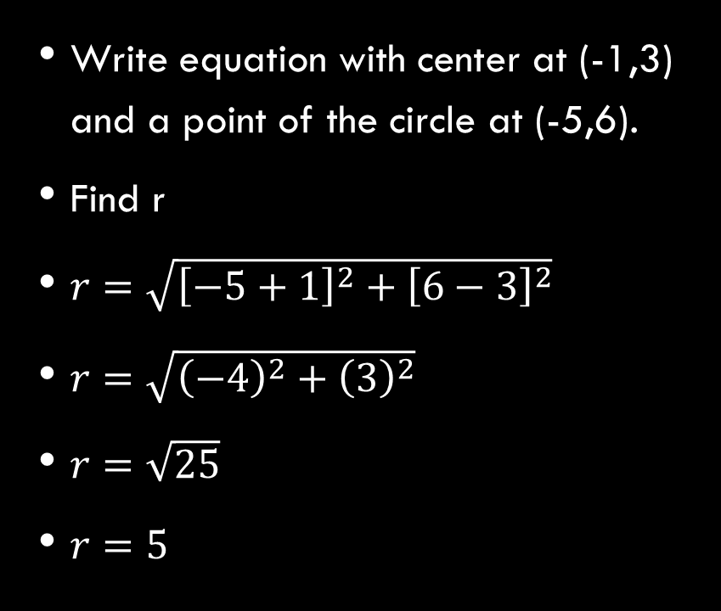
Ex. 2 Writing equation of circles
Write equation with center at (-1,3) and a point of the circle at (-5,6).
Find r
$r=\sqrt{{\left[−5+1\right]}^{2}+{\left[6−3\right]}^{2}}$
$r=\sqrt{{\left(−4\right)}^{2}+{\left(3\right)}^{2}}$
$r=\sqrt{25}$
$r=5$
Steps
1. find r
  Use $r=\sqrt{{\left[x−h\right]}^{2}+{\left[y−k\right]}^{2}}$
2. plug center and r into equation
${\left(x+1\right)}^{2}+{\left(y−3\right)}^{2}=5^{2}$
${\left(x+1\right)}^{2}+{\left(y−3\right)}^{2}=25$

Slide 6
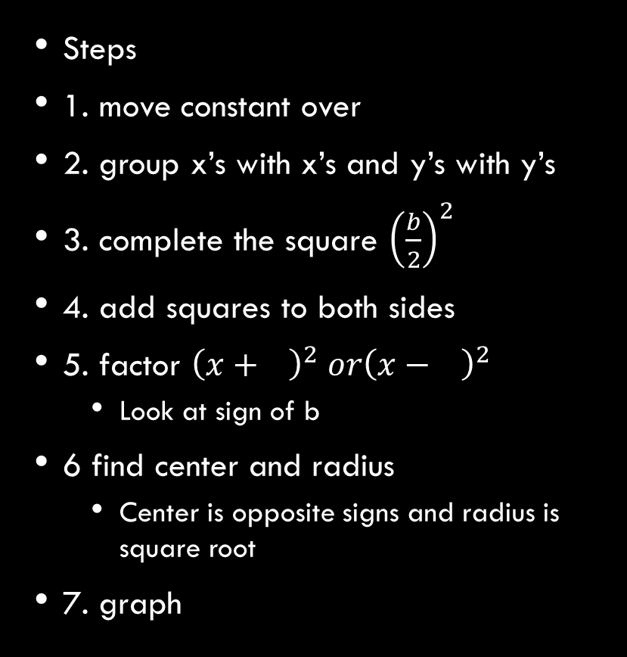
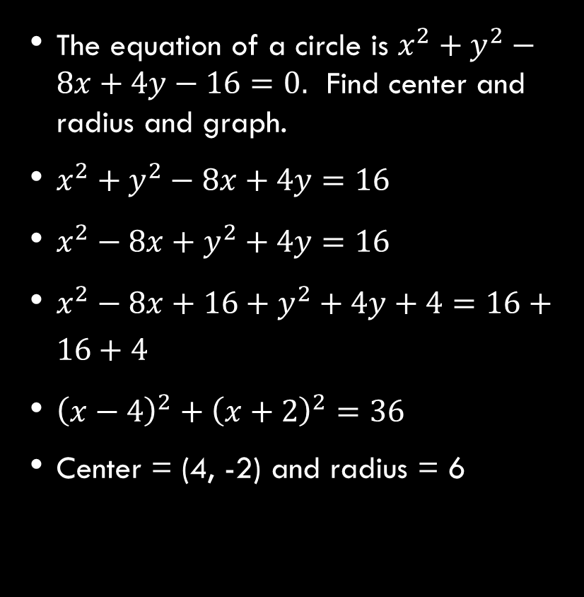
Ex. 3 Graphing a circle
The equation of a circle is $x^{2}+y^{2}−8x+4y−16=0.$ Find center and radius and graph.
$x^{2}+y^{2}−8x+4y=16$
$x^{2}−8x+y^{2}+4y=16$
$x^{2}−8x+16+y^{2}+4y+4=16+16+4$
${\left(x−4\right)}^{2}+{\left(x+2\right)}^{2}=36$
Center = (4, -2) and radius = 6
Steps
1. move constant over
2. group x’s with x’s and y’s with y’s
3. complete the square ${\left(\frac{b}{2}\right)}^{2}$
4. add squares to both sides
5. factor ${\left(x+ \right)}^{2} or{\left(x− \right)}^{2}$
  Look at sign of b
6 find center and radius
  Center is opposite signs and radius is square root
7. graph

