Slide 1
11.3 Shapes of distributions

Slide 2
What we will learn
Describe shapes of data distribution
Use shape to choose appropriate measures
Compare data distributions

Slide 3
Ex. 1 describing shape of distribution
Use frequency table
symmetric
Tickets Sold | Frequency
1-8 | 5
9-16 | 9
17-24 | 16
25-32 | 25
33-40 | 20
41-48 | 8
49-56 | 7

Slide 4
Your Practice
Make a histogram and describe shape of cans collected.
Skewed left
Pounds | Frequency
1-10 | 7
11-20 | 8
21-30 | 10
31-40 | 16
41-50 | 34
51-60 | 15

Slide 5
Making frequency table and histogram
Making histograms
Steps
1. make a frequency table
Use given interval to see how many
Use given amount of intervals
Count how many of each one are in the interval
2. plot on a histogram
Frequency goes up left
Interval goes across bottom

Slide 6
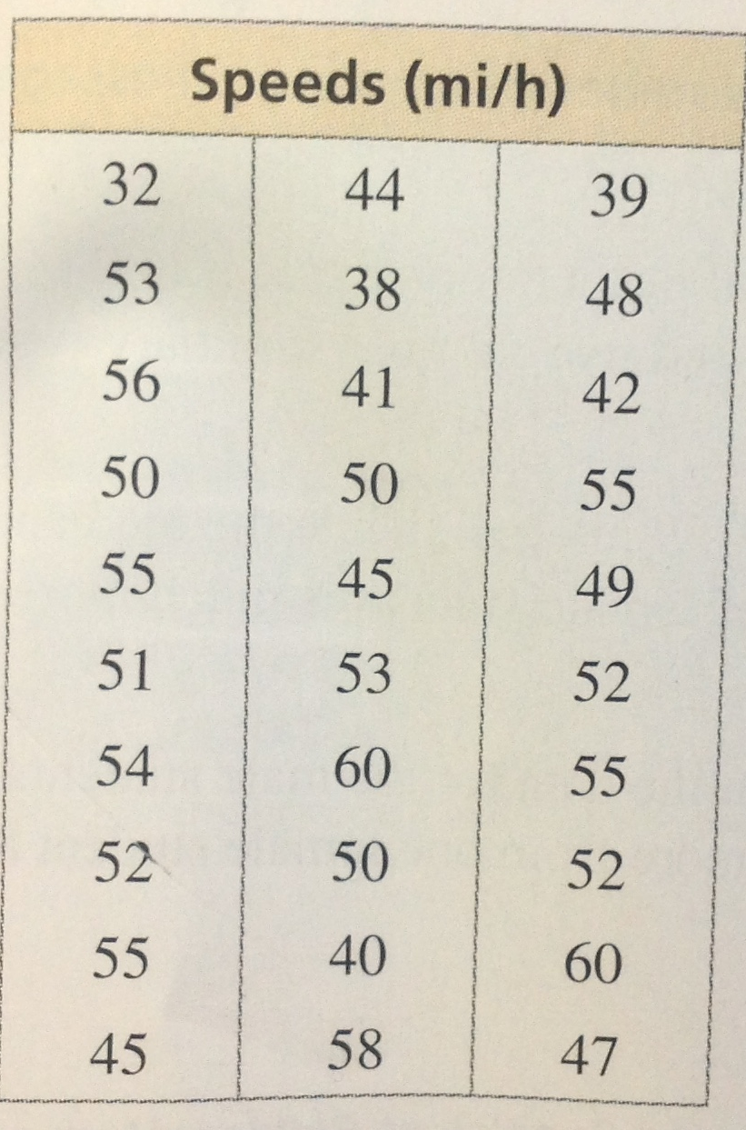
Make frequency Table and histogram
A police officer measures the speeds of 30 motorists. The results are shown in the table. A. display the data in a frequency table and make a histogram.
Speed | Frequency
31-35
1
36-40
3
41-45
5
46-50
6
51-55
11
56-60
4

Slide 7
Ex. 2 Choosing appropriate measures
When distribution is symmetric:
Use mean to describe center, and standard deviation to describe variation
When distribution is skewed:
Use median to describe center, and five number summary for variation
Five number summary is least, Q1, median, Q3, and high
Using speed model, which measures of center and variation best represent the data and how would you interpret the data?
Median and five number summary
Most people go over 45 miles per hour

Slide 8
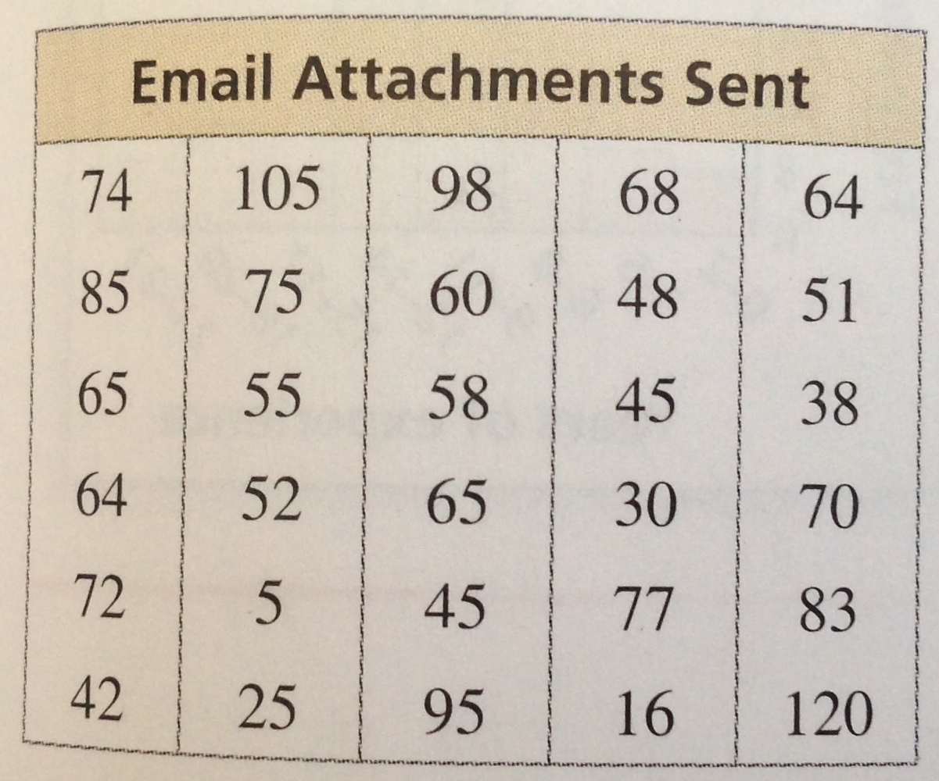
Your Practice
You record the number of email attachments sent by 30 employees of a company in 1 week. Your results are shown in the table. (a) Display that data in a frequency table and histogram using six intervals beginning with 1-20. (b) Which measures of center and variation best represent the data.
Attachments | Frequency
1-20
2
21-40
3
41-60
9
61-80
10
81-100
4
101-120
2

Slide 9
Ex 3 and 4 Comparing Data distributions
The double histogram shows the distributions of emoticon messages sent by a group of female students and a group of male students during one week. Compare the distributions using their shapes and appropriate measures of center and variation.
Basically what is shape and measures of each one
Females:
Symmetric, so use mean and standard deviation
Males:
Skewed right, so use median and five number summary

Slide 10
Ex. 3 and 4 Cont.
The table shows the results of a survey that asked men and women how many pairs of shoes they own.
A. Make a double box and whisker plot and describe shape of distribution.
B. Compare the number of pairs of shoes
Look at medians and means
Similar or different
C. About how many of the women surveyed would you expect to own between 10 and 18 pairs of shoes?
If symmetric shaped, then 68% of data lie within one standard deviation of the mean
95% lie within two of standard deviation

Slide 11
Ex. 3 and 4 Continued
A. men is skewed right and women is symmetric
B. center and spread different with more variation with women
C. 27
.68 * 40 because within one deviation of the mean

