Slide 1
3.4 Proofs with perpendicular lines

Slide 2
What we will learn
Find distance from a point to a line
Using diagrams

Slide 3
Needed vocab
Distance from a point to a line: length of a perpendicular segment from a point to a line
Perpendicular bisector: perpendicular to a segment through the midpoint

Slide 4
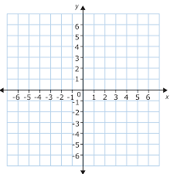
Ex. 1 Finding distance to a segment
Use distance formula
Remember to look for perpendicular segment and use those coordinates
$d=\sqrt{{\left(x_{2}−x_{1}\right)}^{2}+{\left(y_{2}−y_{1}\right)}^{2}}$
$d=\sqrt{{\left(−3−1\right)}^{2}+{\left(3−(−1)\right)}^{2}}$
$d=\sqrt{{(−4)}^{2}+{\left(4\right)}^{2}}$
$d=\sqrt{16+16}$
$d=\sqrt{32 } ≈5.7$
A (-3,3)
D(2,0)
B (-1,-3)
C (1,-1)

Slide 5
Ex. 3 Using perpendicular lines theorems
Which lines if any are parallel and why?
$p∥q$ by Thm. 3.12
$s∥t$ by Thm 3.12
s
t
v
p
q

