Slide 1
3.5 Slope Intercept Form

Slide 2
What We Will Learn
Find slope of a line
Graph slope – intercept form

Slide 3

Needed Vocab
Slope: $\frac{rise}{run} or m=\frac{y_{2}−y_{1}}{x_{2}−x_{1}}$
Rise: change in y ($y_{2}−y_{1}$)
Run: change in x ($x_{2}−x_{1}$)
Slope-intercept form: $y=mx+b$
Constant function: $y=b$ (horizontal line)

Slide 4
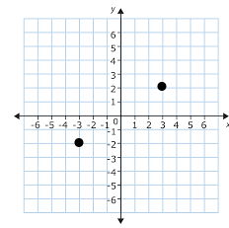
Ex. 1 Find Slope Using Points
Find the slope of the line
Stay consistent
If start with the 2 for y, then start with the 3 for x
If start with the -2 for y, then start with the -3 for x
$m=\frac{y_{2}−y_{1}}{x_{2}−x_{1}}$
$m=\frac{2−(−2)}{3−(−3)}$
$m=\frac{2+2}{3+3}$
$m=\frac{4}{6}=\frac{2}{3}$
(3,2)
(-3,-2)

Slide 5

Your Practice
Find slope of the line passing through (-4,3) and (1,1).
$m=\frac{3−1}{−4−1}$
$m=\frac{2}{−5}$
$m=−\frac{2}{5}$

Slide 6
Ex. 2 Slope From a Table
Find slope from the given table
$m=\frac{14−20}{7−4}$
$m=\frac{−6}{3}$
$m=−2$
Just pick any two points and find slope
X | Y
4 | 20
7 | 14
10 | 8
13 | 2

Slide 7
Your Practice
Find slope from the table
$m=\frac{0−(−2)}{−5−(−9)}$
$m=\frac{0+2}{−5+9}$
$m=\frac{2}{4}$
$m=\frac{1}{2}$
X | Y
-9 | -2
-5 | 0
-1 | 2
3 | 4

Slide 8
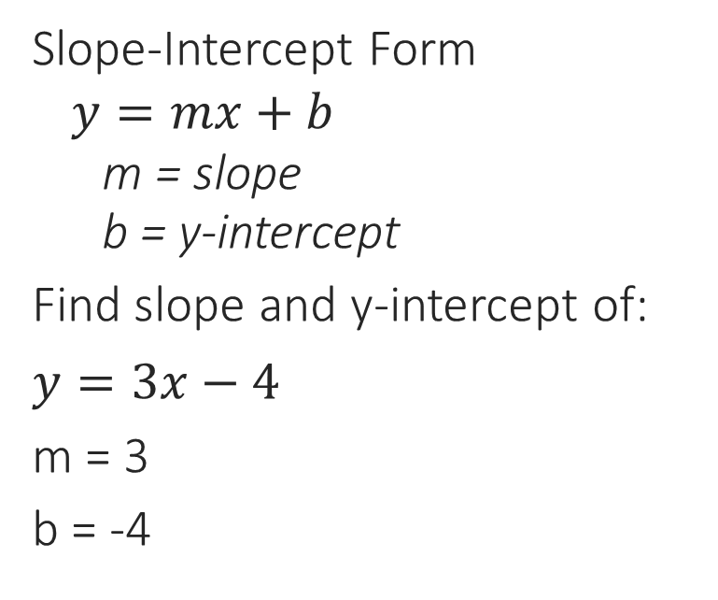
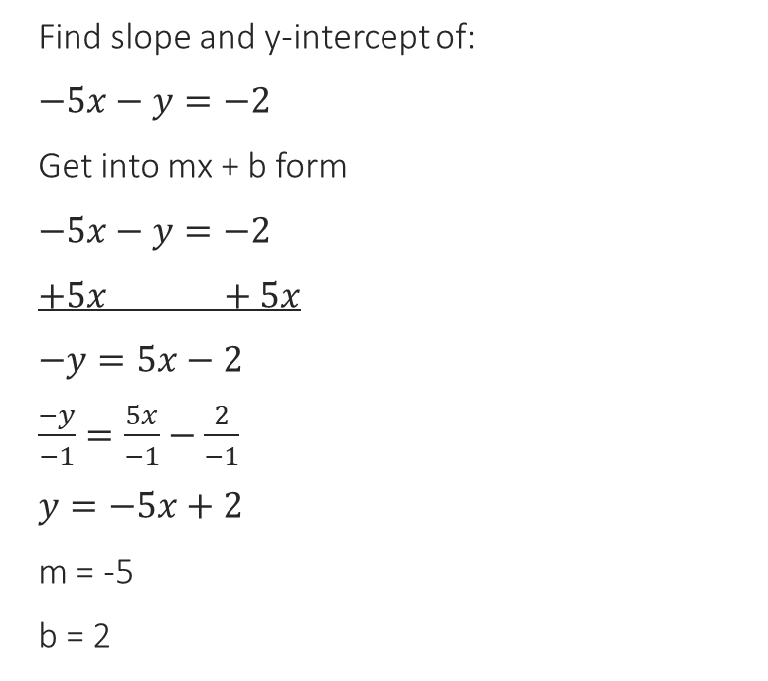
Ex. 3 Using $y=mx+b$
Slope-Intercept Form
$y=mx+b$
m = slope
b = y-intercept
Find slope and y-intercept of:
$y=3x−4$
m = 3
b = -4
Find slope and y-intercept of:
$−5x−y=−2$
Get into mx + b form
$−5x−y=−2$
$+5x +5x$
$−y=5x−2$
$\frac{−y}{−1}=\frac{5x}{−1}−\frac{2}{−1}$
$y=−5x+2$
m = -5
b = 2

Slide 9
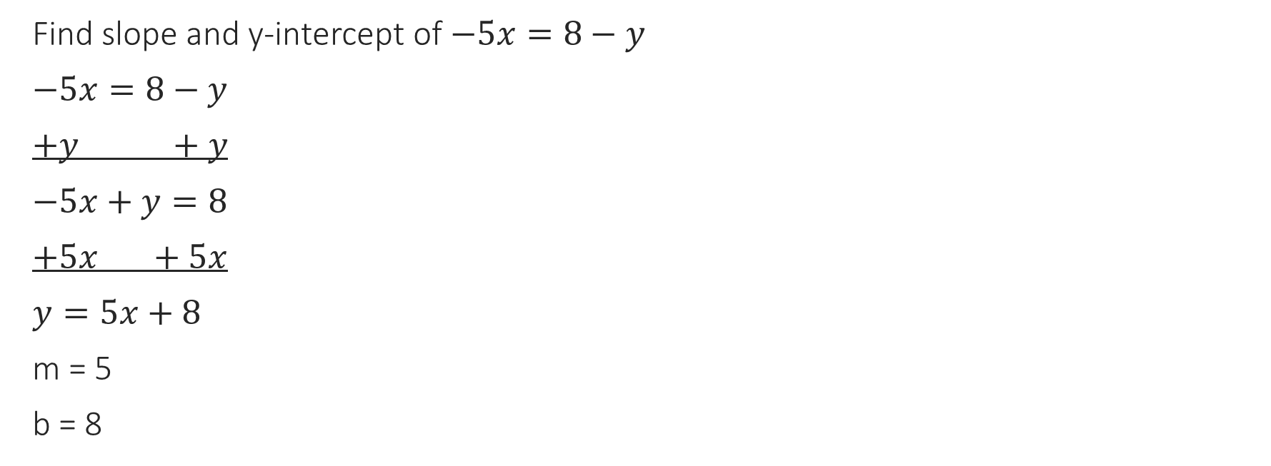
Your Practice
Find slope and y-intercept of $−5x=8−y$
$−5x=8−y$
$+y +y$
$−5x+y=8$
$+5x +5x$
$y=5x+8$
m = 5
b = 8

Slide 10
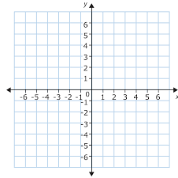

Ex. 4 Graphing
Graph $y=\frac{1}{2}x+3$
Steps
1. get into $y=mx+b$
2. plot the y-intercept
3. from the y-intercept:
Use slope to find second point
4. connect the dots

Slide 11


Ex. 4 Continued
Graph $2x+y=2$
$2x+y=2$
$−2x −2x$
$y=−2x+2$
Your Practice
Graph $x+4y=8$
$−x −x$
$4y=−x+8$
$\frac{4y}{4}=\frac{−x}{4}+\frac{8}{4}$
$y=\frac{−1x}{4}+2$

