Slide 1
5.2 Solve by Substitution

Slide 2
What We Will Learn
Solving by substitution
Story problems

Slide 3
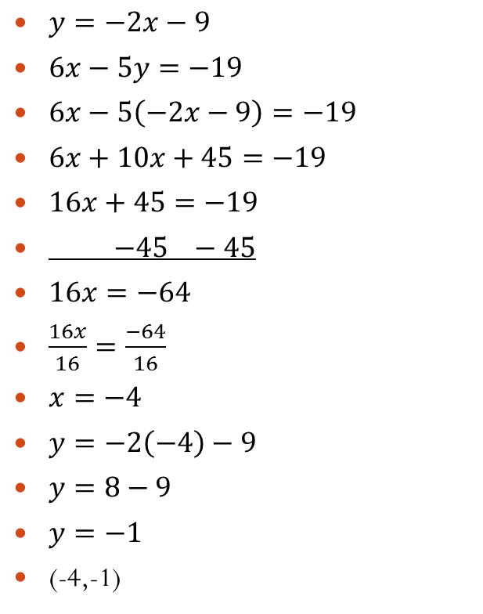
Exs. 1 and 2
$y=−2x−9$
$6x−5y=−19$
$6x−5\left(−2x−9\right)=−19$
$6x+10x+45=−19$
$16x+45=−19$
$−45 −45$
$16x=−64$
$\frac{16x}{16}=\frac{−64}{16}$
$x=−4$
$y=−2\left(−4\right)−9$
$y=8−9$
$y=−1$
(-4,-1)
Steps/Checklist
1. Look for an equation that is solved for a single variable
2. Look for an equation with a variable that is one
Solve for that variable
3. Pick any variable from any equation and solve for it
4. Plug solved variable into other equation and solve for other letter
5. Plug in numerical answer into either original equation and solve
6. Write answer as a point
(x,y)

Slide 4
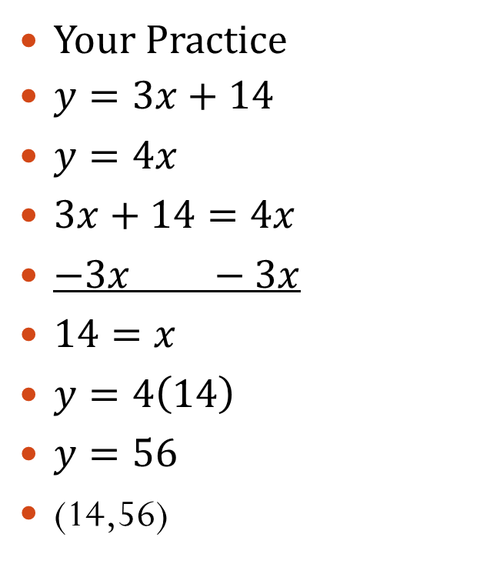
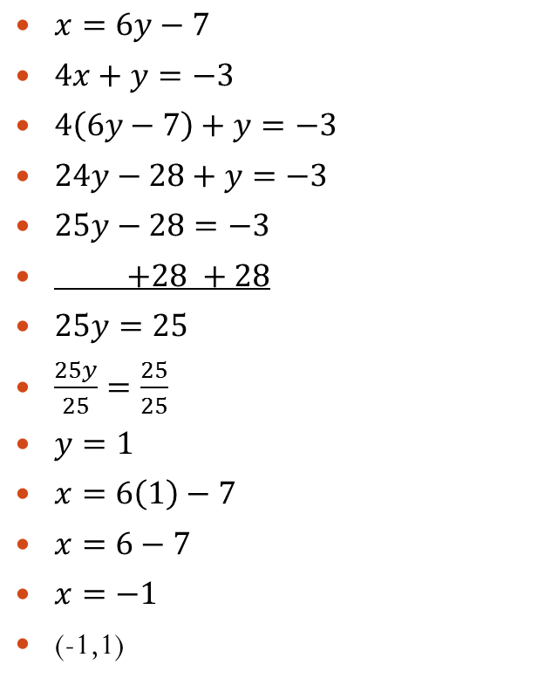
Exs. 1 and 2 Continued
$x=6y−7$
$4x+y=−3$
$4\left(6y−7\right)+y=−3$
$24y−28+y=−3$
$25y−28=−3$
$+28 +28$
$25y=25$
$\frac{25y}{25}=\frac{25}{25}$
$y=1$
$x=6\left(1\right)−7$
$x=6−7$
$x=−1$
(-1,1)
Your Practice
$y=3x+14$
$y=4x$
$3x+14=4x$
$−3x −3x$
$14=x$
$y=4\left(14\right)$
$y=56$
(14,56)

Slide 5
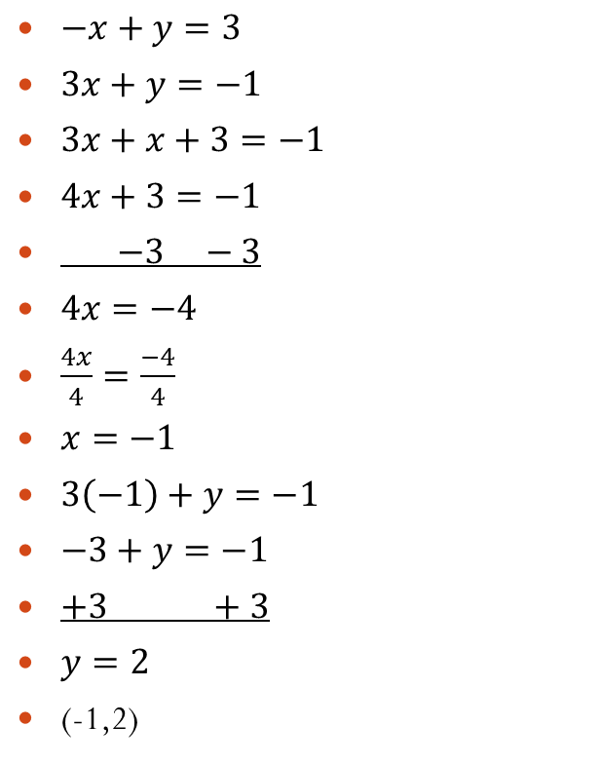
Exs. 1 and 2 cont.
$−x+y=3$
$3x+y=−1$
$3x+x+3=−1$
$4x+3=−1$
$−3 −3$
$4x=−4$
$\frac{4x}{4}=\frac{−4}{4}$
$x=−1$
$3\left(−1\right)+y=−1$
$−3+y=−1$
$+3 +3$
$y=2$
(-1,2)
Both have a variable with coefficient of one: so pick on equation and solve for that variable
$−x+y=3$
$+x +x$
$y=x+3$
Plug this into second equation

Slide 6


Your Practice
$x+y=−2$
$−3x+y=6$
$−3\left(−y−2\right)+y=6$
$3y+6+y=6$
$4y+6=6$
$−6 −6$
$4y=0$
$\frac{4y}{4}=\frac{0}{4}$
$y=0$
$x+0=−2$
$x=−2$
(-2,0)
$x+y=−2$
$−y −y$
$x=−y−2$

Slide 7
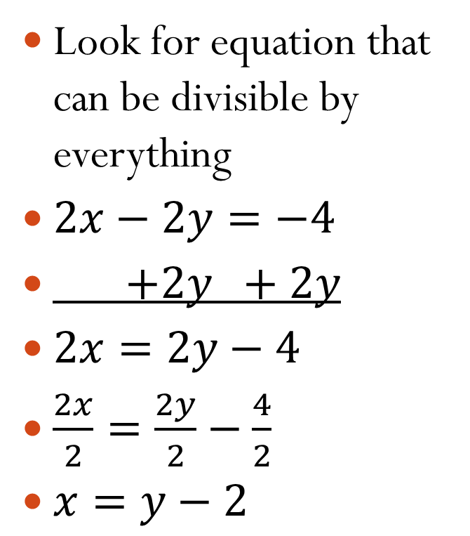
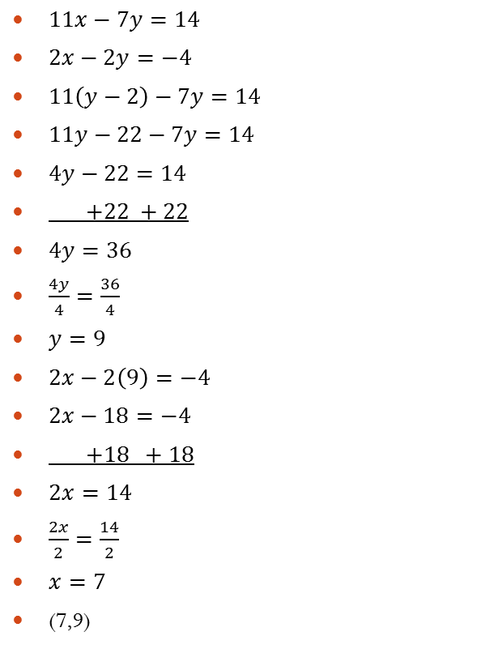
Exs. 1 and 2 cont
$11x−7y=14$
$2x−2y=−4$
$11\left(y−2\right)−7y=14$
$11y−22−7y=14$
$4y−22=14$
$+22 +22$
$4y=36$
$\frac{4y}{4}=\frac{36}{4}$
$y=9$
$2x−2\left(9\right)=−4$
$2x−18=−4$
$+18 +18$
$2x=14$
$\frac{2x}{2}=\frac{14}{2}$
$x=7$
(7,9)
Look for equation that can be divisible by everything
$2x−2y=−4$
$+2y +2y$
$2x=2y−4$
$\frac{2x}{2}=\frac{2y}{2}−\frac{4}{2}$
$x=y−2$

Slide 8
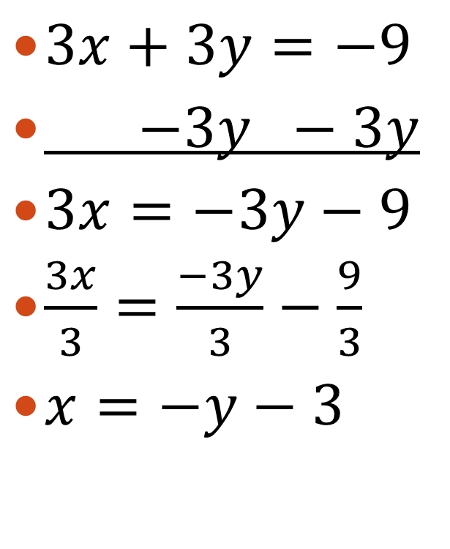
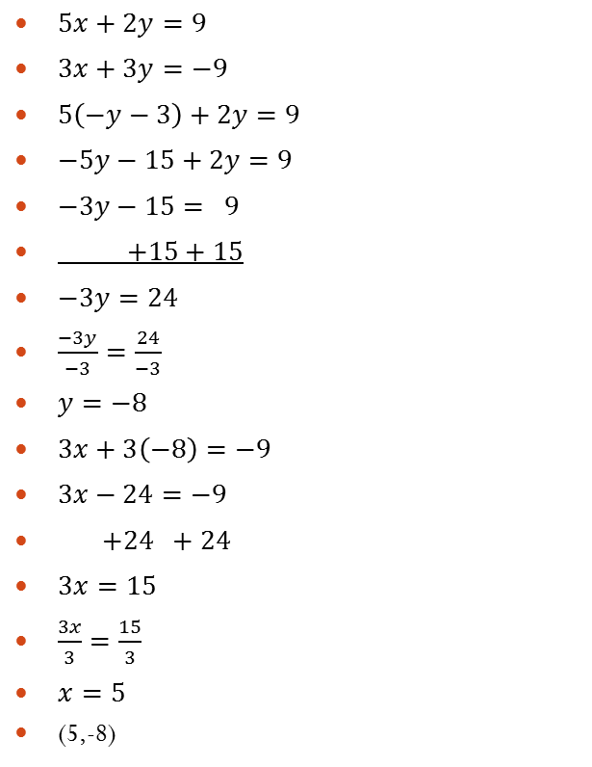
Your Practice
$5x+2y=9$
$3x+3y=−9$
$5\left(−y−3\right)+2y=9$
$−5y−15+2y=9$
$−3y−15= 9$
$+15+15$
$−3y=24$
$\frac{−3y}{−3}=\frac{24}{−3}$
$y=−8$
$3x+3\left(−8\right)=−9$
$3x−24=−9$
$+24 +24$
$3x=15$
$\frac{3x}{3}=\frac{15}{3}$
$x=5$
(5,-8)
$3x+3y=−9$
$−3y −3y$
$3x=−3y−9$
$\frac{3x}{3}=\frac{−3y}{3}−\frac{9}{3}$
$x=−y−3$

Slide 9
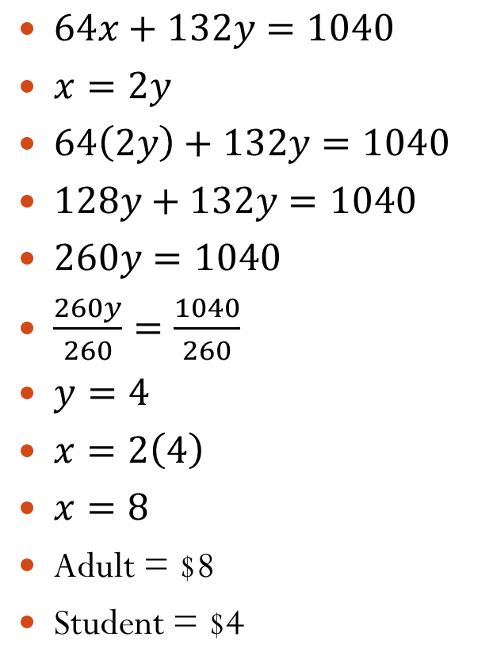
Ex. 3 Story Problems
A drama club earns $1040 from a production. A total of 64 adult tickets and 132 student tickets were sold. An adult ticket costs twice as much as a student ticket. Write a system of equations. What is the price of each ticket?
Adult = x
Student = y.
2 equations
1. number of tickets sold
2. cost of tickets
$64x+132y=1040$
$x=2y$
$64\left(2y\right)+132y=1040$
$128y+132y=1040$
$260y=1040$
$\frac{260y}{260}=\frac{1040}{260}$
$y=4$
$x=2\left(4\right)$
$x=8$
Adult = $8
Student = $4

Slide 10
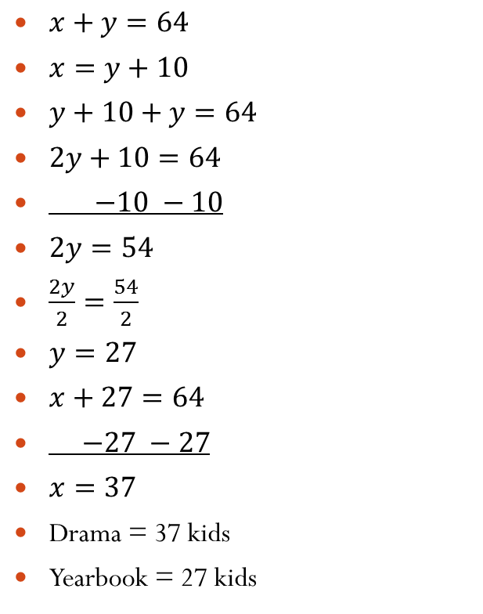
Your Practice
There are a total of 64 students in a drama club and a yearbook club. The drama club has 10 more students than the yearbook club. Write system of equations. How many students in each club?
Drama = x
Yearbook = y
$x+y=64$
$x=y+10$
$y+10+y=64$
$2y+10=64$
$−10 −10$
$2y=54$
$\frac{2y}{2}=\frac{54}{2}$
$y=27$
$x+27=64$
$−27 −27$
$x=37$
Drama = 37 kids
Yearbook = 27 kids

