Slide 1
5.3 solve by elimination

Slide 2
What we will learn
Solve by elimination
Story problems

Slide 3

Exs. 1 and 2 solve by elimination
$3x+2y=4$
$3x−2y=−4$
$6x =0$
$\frac{6x}{6}=\frac{0}{6}$
$x=0$
$3\left(0\right)+2y=4$
$2y=4$
$\frac{2y}{2}=\frac{4}{2}$
$y=2$
(0,2)
Steps/Look for
1. Look for variables with same coefficient AND opposite signs
2. Look for variables with same coefficient OR opposite signs
If opposite signs; multiply to get same coefficient
Must multiply everything in equation
If same coefficient; multiply by -1 to everything
3. Pick a variable to multiply to get same coefficient and opposite signs
4. Eliminate variable
5. Plug in numerical answer into either original equation
6. Solve for other variable
7. Write as a point
(x,y)

Slide 4

Your practice
$3x+2y=7$
$−3x+4y=5$
$6y=12$
$\frac{6y}{6}=\frac{12}{6}$
$y=2$
$3x+2\left(2\right)=7$
$3x+4=7$
$−4 −4$
$3x=3$
$\frac{3x}{3}=\frac{3}{3}$
$x=1$
(1,2)

Slide 5

Exs. 1 and 2 cont
$x−3y=24$
$3x+y=12$
$x−3y=24$
$9x+3y=36$
$10x =60$
$\frac{10x}{10}=\frac{60}{10}$
$x=6$
$6−3y=24$
$−6 −6$
$−3y=18$
$\frac{−3y}{−3}=\frac{18}{−3}$
$y=−6$
(6,-6)
Y’s have opposite signs, so multiply to get same coefficient
Remember to multiply whole equation
$3\left(3x+y=12\right)$
$9x+3y=36$

Slide 6

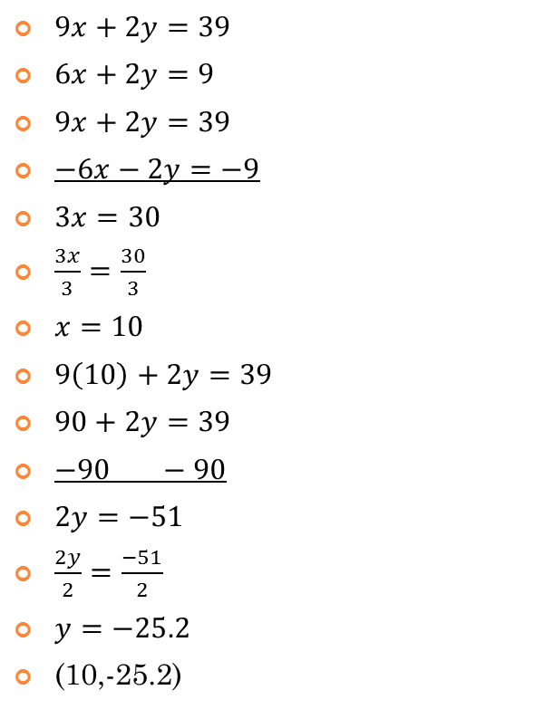
Your Practice
$9x+2y=39$
$6x+2y=9$
$9x+2y=39$
$−6x−2y=−9$
$3x=30$
$\frac{3x}{3}=\frac{30}{3}$
$x=10$
$9\left(10\right)+2y=39$
$90+2y=39$
$−90 −90$
$2y=−51$
$\frac{2y}{2}=\frac{−51}{2}$
$y=−25.2$
(10,-25.2)
Have same coefficient; multiply one equation by -1
$−1\left(6x+2y=9\right)$
$−6x−2y=−9$

Slide 7
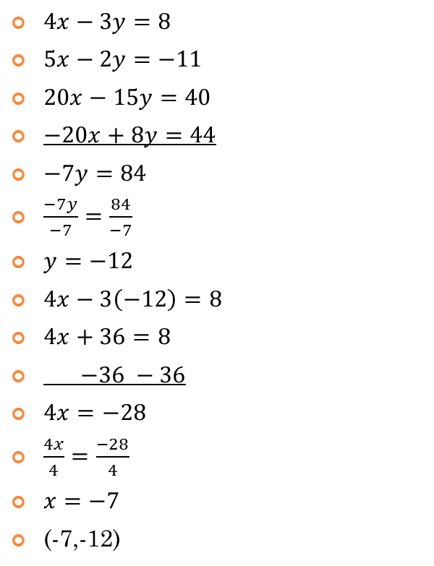
Exs. 1 and 2 cont
$4x−3y=8$
$5x−2y=−11$
$20x−15y=40$
$−20x+8y=44$
$−7y=84$
$\frac{−7y}{−7}=\frac{84}{−7}$
$y=−12$
$4x−3\left(−12\right)=8$
$4x+36=8$
$−36 −36$
$4x=−28$
$\frac{4x}{4}=\frac{−28}{4}$
$x=−7$
(-7,-12)
Nothing opposite or same
Pick a variable to get rid of and multiply to get opposite signs and same coefficient
Going to get rid of x’s
$5\left(4x−3y=8\right)$
$20x−15y=40$
$−4\left(5x−2y=−11\right)$
$−20x+8y=44$
Use these two equations

Slide 8

Your Practice
$9x+2y=39$
$6x+13y=−9$
$117x+26y=507$
$−12x−26y=18$
$105x=525$
$\frac{105x}{105}=\frac{525}{105}$
$x=5$
$9\left(5\right)+2y=39$
$45+2y=39$
$−45 −45$
$2y=−6$
$\frac{2y}{2}=\frac{−6}{2}$
$y=−3$
(5,-3)
Going to get rid of y’s
$13\left(9x+2y=39\right)$
$117x+26y=507$
$−2\left(6x+13y=−9\right)$
$−12x−26y=18$

Slide 9
Ex. 3 story problems
A business with two locations buys seven large delivery vans and five small vans. Location A gets five large and two small for $235,000 and location B gets two large and three small for $160,000. Write system and find the cost of each van.
Write 2 equations
Location A
$5l+2s=235,000$
Location B
$2l+3s=160,000$
Do like very last practice problem we did

