Slide 1
5.5 Solving Linear Equations by Graphing

Slide 2
What We Will Learn
Solving linear and absolute value equations using graphing calculator
Story problems

Slide 3
Ex. 1 Solve Linear by Graphing
Solve $−x+1=2x−5$ by graphing.
Steps to solving
1. separate into two y = equations
2. Type into calculator
3. Find intersection
4. Answer is x value
x = 2
Steps to calculator work
1. push y = button
2. type in equations
3. push 2nd Trace
4. push number 5
5. push enter 3 times

Slide 4
Your Practice
Solve $−4+9x=−3x+2$
x = .5

Slide 5
Ex. 2 Solve Absolute Value by Graphing
Solve $\left|x+1\right|=\left|2x−4\right|$
Same as example 1 only have to sets of equations
Write each set as equal parts:
$x+1=2x−4$
$y=x+1 and y=2x−4$
$x+1=−2x+4$
$y=x+1 and y=−2x+4$
Put each set in calculator like example one to get two answers
x = 1 and 5

Slide 6
Your Practice
Solve $\left|2x+2\right|=\left|x−2\right|$
$2x+2=x−2$
x = -4
$2x+2=−x+2$
x = 0

Slide 7
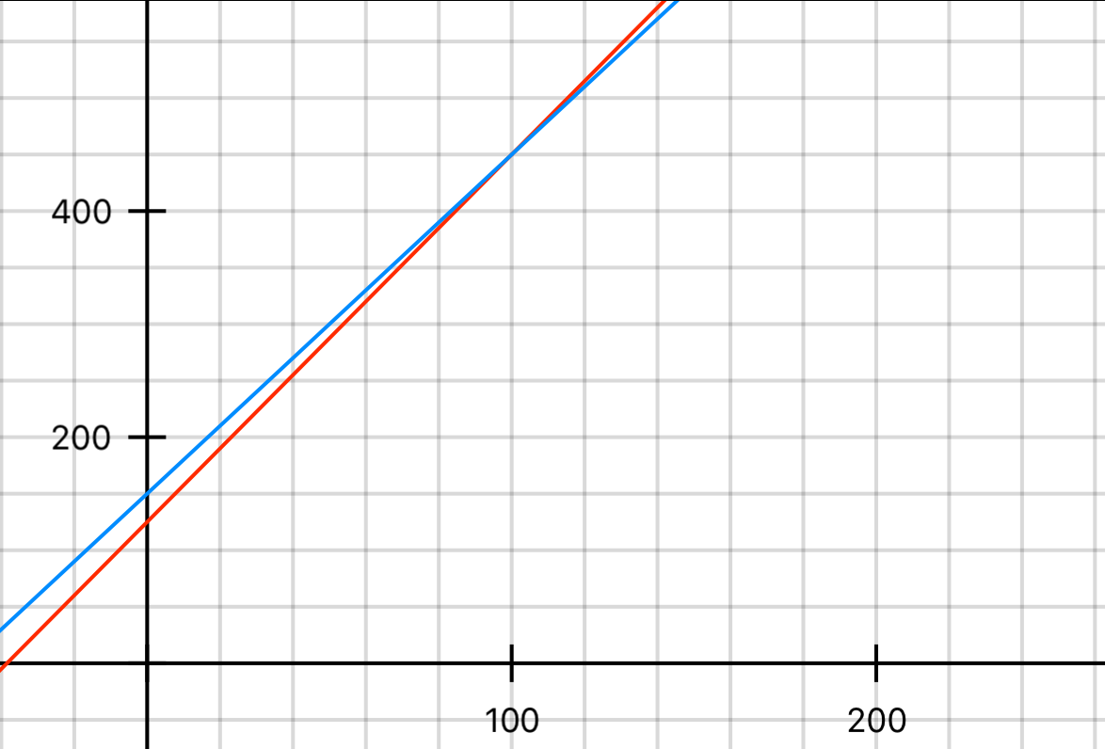
Ex. 3 Story Problems
Your family needs to rent a car for a week while on vacation. Company A charges $3.25 per mile plus a flat fee of $125 per week. Company B charges $3 per mile plus a flat fee of $150 per week. After how many miles of travel are the total costs the same at both companies?
Write the equation
Company A = Company B
3.25x + 125 = 3x + 150
Put in calculator and graph and find intersection.
Remember look for x value
100 miles

