Slide 1
5.6 Using ASA and AAS

Slide 2
What We Will Learn
Prove using ASA and AAS

Slide 3
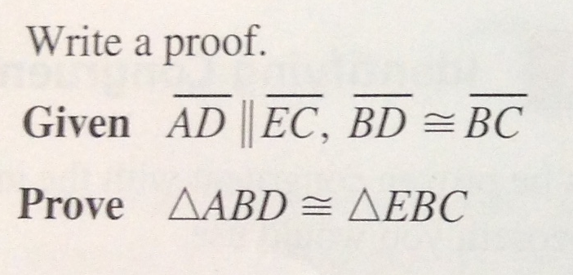
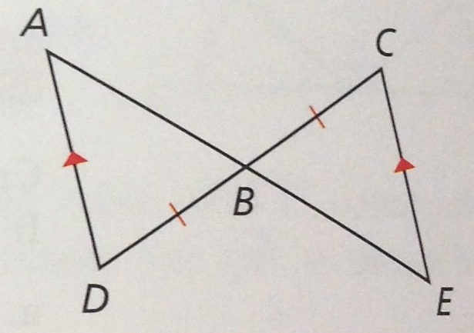
Ex. 2 Using ASA
Notice letter placement
Side must be between the two congruent angles
Statement | Reason
1. $\overline{AD}∥\overline{EC}, \overline{BD}≅\overline{BC}$ | 1. Given
2. $∠ADB≅∠ECB$
2. Alt. Int. Angles
3. $∠ABD≅∠EBC$
3. Vertical Angles
4. $∆ABD≅∆EBC$
4. ASA

Slide 4
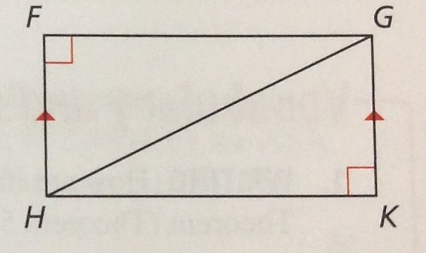
Ex. 3 Using AAS
Notice congruent side CANNOT be between congruent angles
Statement | Reason
1. $\overline{HF}∥\overline{GK}, ∠F and ∠K$are right angles | 1. Given
2. $∠F≅∠K$
2. Thm 2.3
3. $∠FHG≅∠KGH$
3. Alt. Int. Angles
4. $\overline{HG}≅\overline{HG}$
4. Reflex. Prop.
5. $∆HFG≅∆GKH$
5. AAS

