Slide 1
5.7 CPCTC

Slide 2
What We Will Learn
Using CPCTC

Slide 3
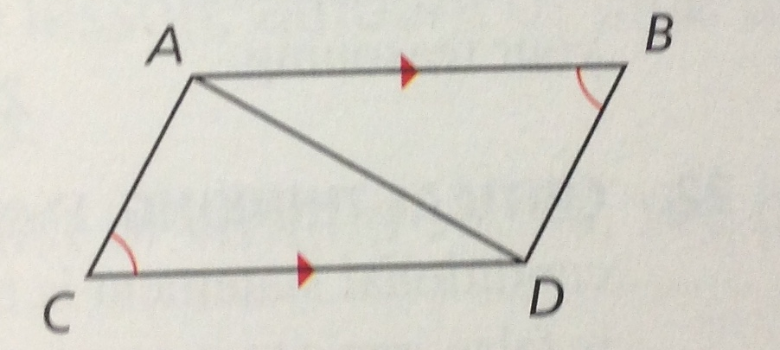

Using CPCTC
CPCTC is Corresponding Parts of Congruent Triangles are Congruent
Show two triangles congruent first, then corresponding parts are congruent
Use CPCTC in proof
Given: picture
Prove: $\overline{AC}≅\overline{DB}$
Statement | Reason
1. $\overline{AB}∥\overline{CD}, ∠C≅∠B$ | 1. Given
2. $∠CAD≅∠BDA$
2. Alt. Int. Angles
3. $\overline{AD}≅\overline{AD}$
3. Reflex. Prop.
4. $∆ACD≅∆DBA$
4. AAS
5. $\overline{AC}≅\overline{DB}$
5. CPCTC

