Slide 1
6.2 Radicals and Rational Exponents

Slide 2
What We Will Learn
Finding nth root
Evaluating rational exponents
Story problems

Slide 3
Needed Vocab
Radical: square root of a number; $\sqrt{a}$
Radicand: number inside square root
Index of a radical: the root of the radical; $\sqrt[n]{a}$

Slide 4
Ex. 1 Finding nth Root
Core Concept: $\sqrt[n]{a}$
If n is odd, then $\sqrt[n]{a}$ has one answer.
If n is even, then $\sqrt[n]{a}$ has two answers.
$±$ answer
If n is even and a = $0$, then $\sqrt[n]{0}=0$.
If n is even and a $<0$, then $\sqrt[n]{−a}$ is no solution.
Find nth root of a for:
$n=3 and a=−27$
Plug in calculator
$\sqrt[3]{−27}=−3$

Slide 5
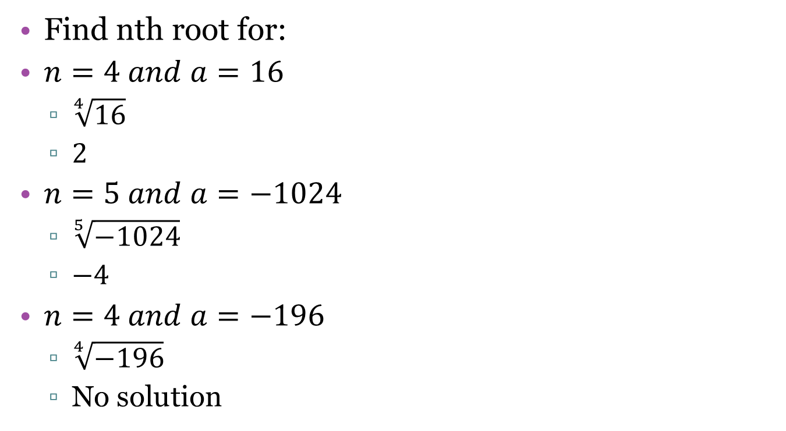
Your Practice
Find nth root for:
$n=4 and a=16$
$\sqrt[4]{16}$
$2$
$n=5 and a=−1024$
$\sqrt[5]{−1024}$
$−4$
$n=4 and a=−196$
$\sqrt[4]{−196}$
No solution

Slide 6

Exs. 2 and 3 Evaluating Expressions
$\sqrt[3]{−8}$
$−2$
-$\sqrt[3]{8}$
$−2$
${128}^{1/7}$
Use $a^{m/n}=\sqrt[n]{a^{m}}$
Do inside exponent first, then do root
$\sqrt[7]{{128}^{1}}$
$\sqrt[7]{128}$
$2$

Slide 7

Your Practice
Evaluate
${27}^{4/3}$
$\sqrt[3]{{27}^{4}}$
$\sqrt[3]{531441}$
$81$
${16}^{3/4}$
$\sqrt[4]{{16}^{3}}$
$\sqrt[4]{4096}$
$8$

Slide 8
Exs. 4 and 5 Story Problems
They will give equation to use. Just plug in letter you are trying to find
$r={\left(\frac{3V}{4π}\right)}^{1/3}$
$V=113$
$r={\left(\frac{3(113)}{4π}\right)}^{1/3}$
$r={\left(\frac{339}{4π}\right)}^{1/3}$
$r={\left(\frac{339}{12.57}\right)}^{1/3}$
$r={\left(26.98\right)}^{1/3}$
$r=3$

