Slide 1
6.3 Medians and altitudes

Slide 2
What we will learn
Use medians to find centroids
Use altitudes to find orthocenters

Slide 3
Needed vocab
Median of a triangle: segment from a vertex to the midpoint of the opposite side
Centroid: point of concurrency of medians
Altitude: perpendicular segment from a vertex to the opposite side or line that contains the opposite side
Orthocenter: point of concurrency of the altitudes

Slide 4
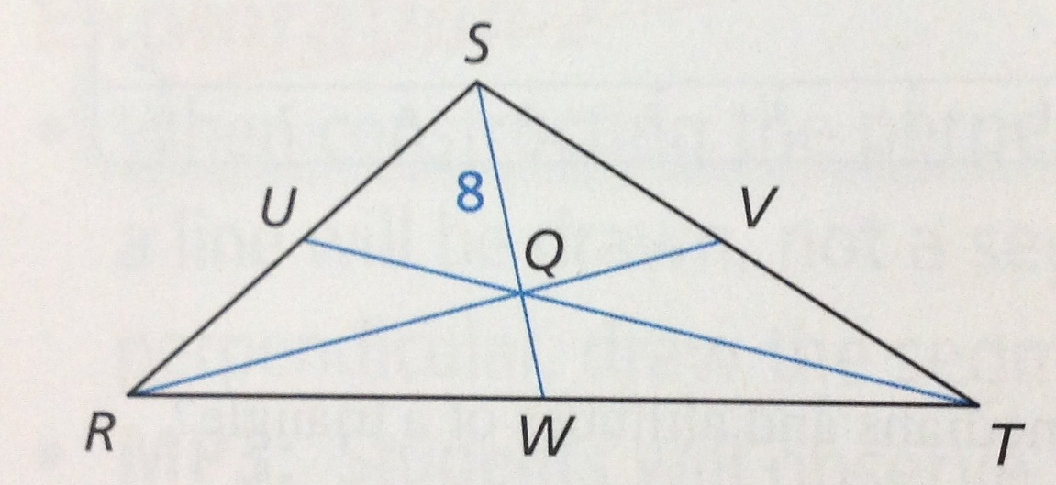
Ex. 1 using centroid
Q is the centroid and SQ = 8. Find QW and SW
Use Centroid Thm
$SQ=\frac{2}{3}SW$
$8=\frac{2}{3}SW$
$\left(\frac{3}{2}\right)8=\frac{2}{3}SW\left(\frac{3}{2}\right)$
$12=SW$
QW = SW – SQ
QW = 12 – 8
QW = 4

Slide 5
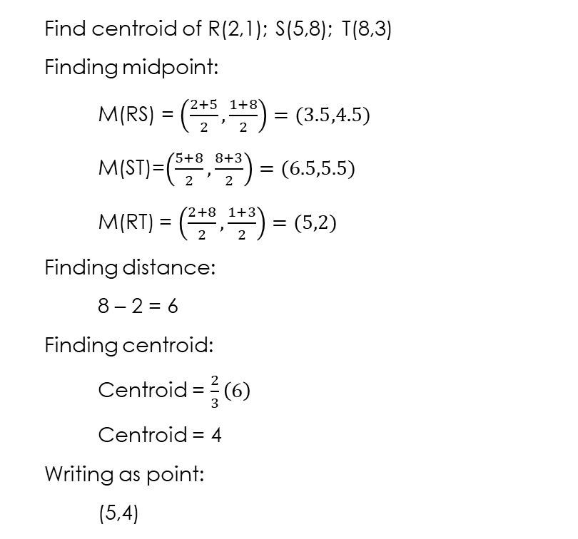
Ex. 2 find centroid
Find centroid of R(2,1); S(5,8); T(8,3)
Finding midpoint:
M(RS) = $\left(\frac{2+5}{2},\frac{1+8}{2}\right)=(3.5,4.5)$
M(ST)=$\left(\frac{5+8}{2},\frac{8+3}{2}\right)=(6.5,5.5)$
M(RT) = $\left(\frac{2+8}{2},\frac{1+3}{2}\right)=(5,2)$
Finding distance:
8 – 2 = 6
Finding centroid:
Centroid = $\frac{2}{3}\left(6\right)$
Centroid = 4
Writing as point:
(5,4)
Steps
1. Graph because centroid has to be inside triangle
2. find midpoint of each side
Midpoint =$\left(\frac{x_{1}+x_{2}}{2},\frac{y_{1}+y_{2}}{2}\right)$
3. look for side and midpoint that have the same x or y value
4. find distance between those values
5. use centroid thm to find centroid length
6. add or subtract centroid length from x or y value to get centroid inside the triangle
7. write answer froom repeated x or y value and the answer from step 6 as a point

Slide 6

Your practice
Find coordinate of the centroid of A(2,3); B(8,1); C(5,7)
M(AB)$=\left(\frac{2+8}{2},\frac{3+1}{2}\right)=(5,2)$
M(AC)$=\left(\frac{2+5}{2},\frac{3+7}{2}\right)=(2.5,5)$
M(BC)$=\left(\frac{8+5}{2},\frac{1+7}{2}\right)=(6.5,4)$
7 – 2 = 5
Centroid = $\frac{2}{3}\left(5\right)$
Centroid = $\frac{10}{3}$
Coordinate is (5,$\frac{10}{3}$)

Slide 7
Ex. 3 finding orthocenter
4. use point opposite side you found slope of and perpendicular slope to find b
5. write equation of altitude
6. plug in x value from step one into altitude equation to find y
7. answer is point using x value from step one and y value from step 5
Steps
1. graph the points to find horizontal side
2. find equation of line perpendicular to horizontal side
Use x value from point opposite horizontal line
x = c
3. find slope of another side and use negative reciprocal to find equation

Slide 8
Ex. 3 continued
Find orthocenter of X(-5,-1); Y(-2,4); Z(3,-1)
x = -2
$m=\frac{4+1}{−2−3}=\frac{5}{−5}=−1$
So perpendicular slope is 1
$−1=1\left(−5\right)+b$
$−1=−5+b$
$+5 +5$
$4=b$
$y=x+4$
$y=−2+4$
$y=2$
Orthocenter is at (-2,2)

Slide 9
Practice
Find orthocenter of L(0,5); M(3,1); N(8,1)
x = 0
$m=\frac{5−1}{0−8}=\frac{4}{−8}=−\frac{1}{2}$
Perpendicular slope is 2
$1=2\left(3\right)+b$
$1=6+b$
$−6−6$
$−5=b$
$y=2x−5$
$y=2\left(0\right)−5$
$y=−5$
Orthocenter is (0,-5)

