Slide 1
7.3 Special Products

Slide 2
What We Will Learn
Use square of a binomial pattern
Use sum and difference pattern

Slide 3
Ex. 1 Square of a Binomial
${\left(a+b\right)}^{2}=\left(a+b\right)\left(a+b\right)=a^{2}+2ab+b^{2}$
${\left(a−b\right)}^{2}=\left(a−b\right)\left(a−b\right)=a^{2}−2ab+b^{2}$
If forget pattern, just use any method of multiplying learned before
FOIL, distribute, or table
Multiply:
${\left(3x+4\right)}^{2}=\left(3x+4\right)\left(3x+4\right)$
a = 3x
b = 4
${9x}^{2}+24x+16$

Slide 4
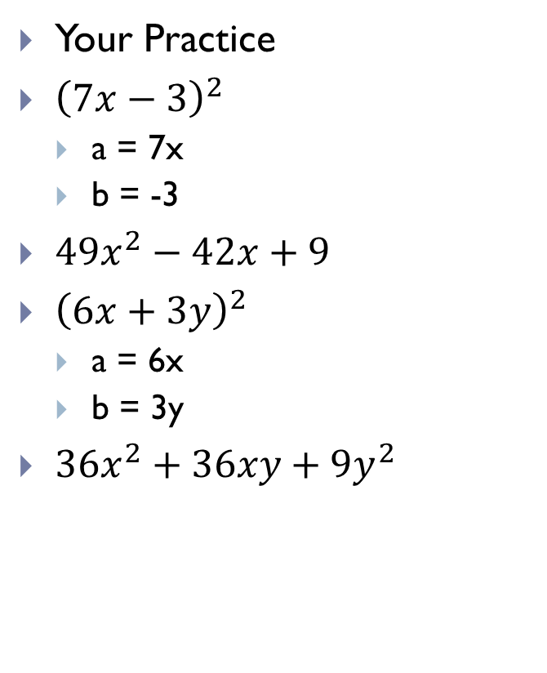
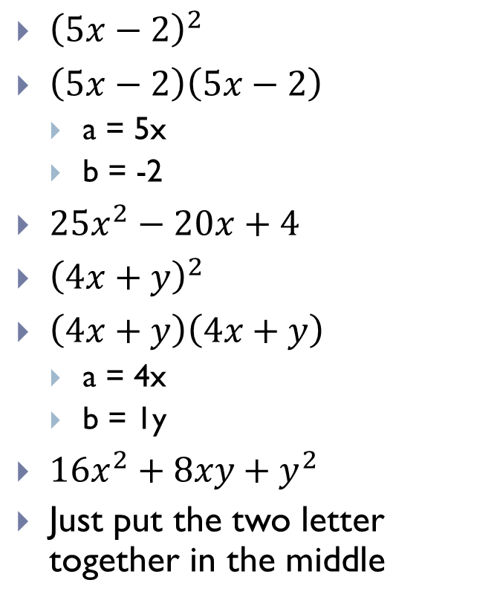
Ex. 1 Cont.
${\left(5x−2\right)}^{2}$
$\left(5x−2\right)\left(5x−2\right)$
a = 5x
b = -2
${25x}^{2}−20x+4$
${\left(4x+y\right)}^{2}$
$\left(4x+y\right)\left(4x+y\right)$
a = 4x
b = 1y
${16x}^{2}+8xy+y^{2}$
Just put the two letter together in the middle
Your Practice
${\left(7x−3\right)}^{2}$
a = 7x
b = -3
${49x}^{2}−42x+9$
${\left(6x+3y\right)}^{2}$
a = 6x
b = 3y
${36x}^{2}+36xy+{9y}^{2}$

Slide 5
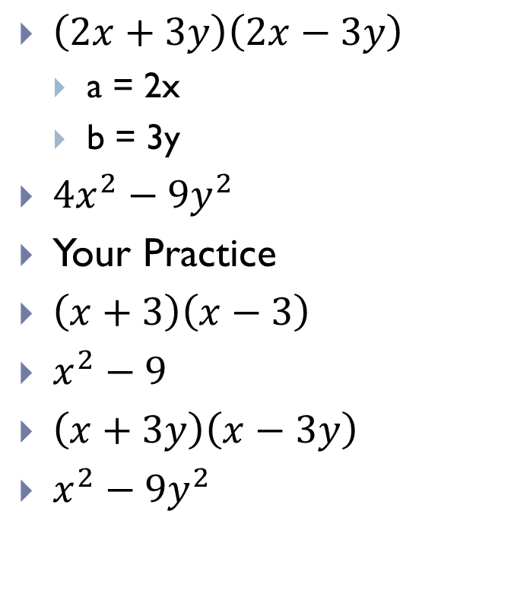
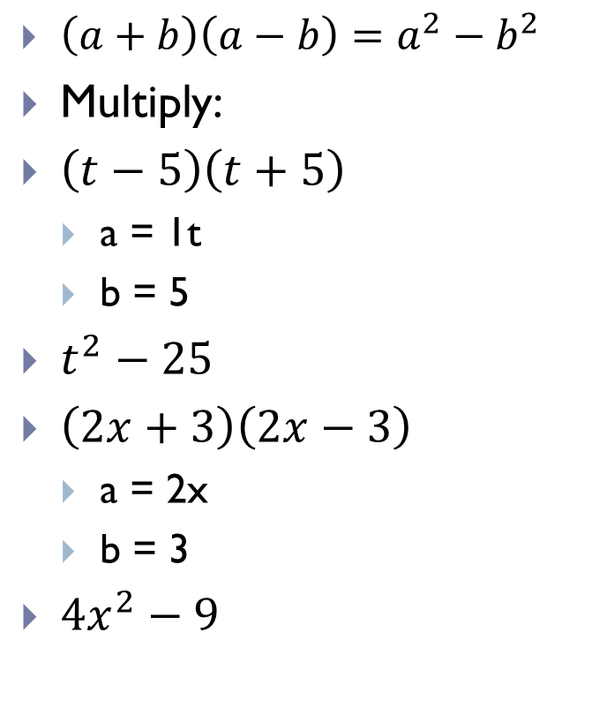
Ex. 2 Sum and Difference Pattern
$\left(a+b\right)\left(a−b\right)=a^{2}−b^{2}$
Multiply:
$\left(t−5\right)\left(t+5\right)$
a = 1t
b = 5
$t^{2}−25$
$\left(2x+3\right)\left(2x−3\right)$
a = 2x
b = 3
${4x}^{2}−9$
$\left(2x+3y\right)\left(2x−3y\right)$
a = 2x
b = 3y
${4x}^{2}−{9y}^{2}$
Your Practice
$\left(x+3\right)\left(x−3\right)$
$x^{2}−9$
$\left(x+3y\right)\left(x−3y\right)$
$x^{2}−{9y}^{2}$

Slide 6

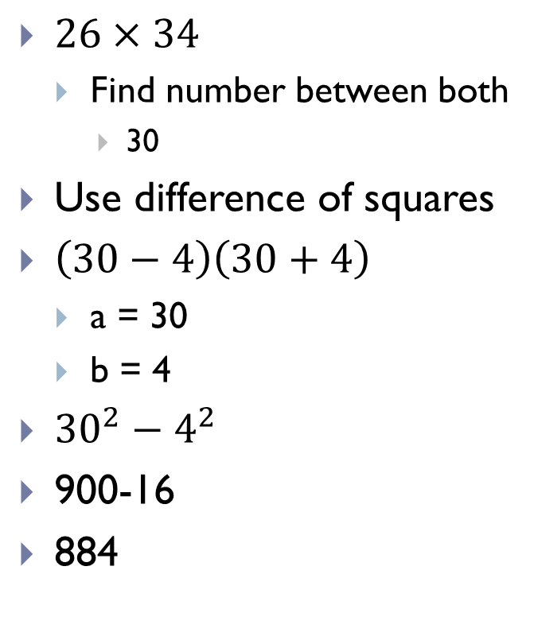
Ex. 3 Mental Math
$26×34$
Find number between both
30
Use difference of squares
$\left(30−4\right)\left(30+4\right)$
a = 30
b = 4
${30}^{2}−4^{2}$
900-16
884
$16×24$
20
$\left(20−4\right)\left(20+4\right)$
a = 20
b = 4
${20}^{2}−4^{2}$
$400−16$
384

Slide 7
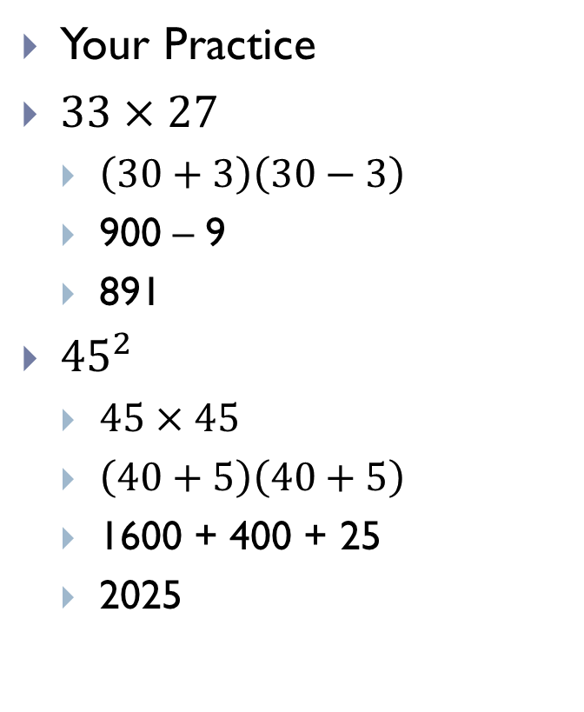
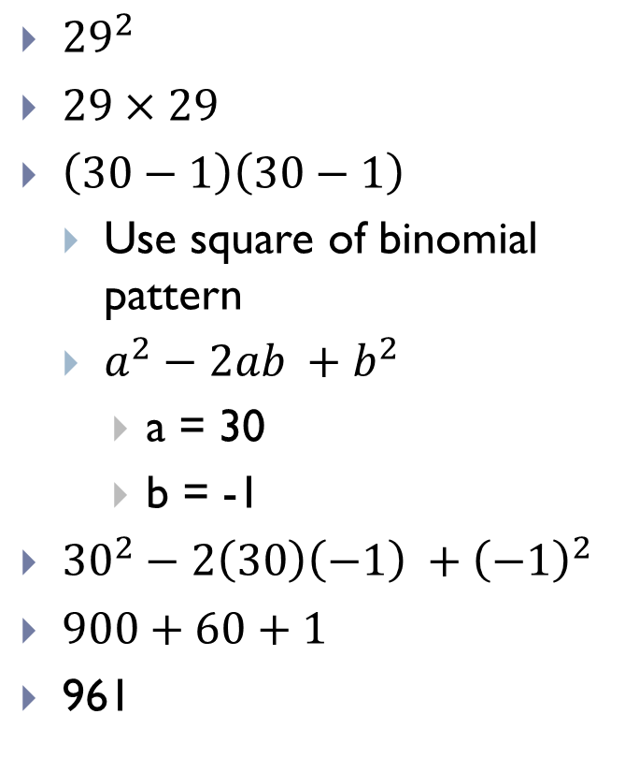
Ex. 3 Cont.
${29}^{2}$
$29×29$
$\left(30−1\right)\left(30−1\right)$
Use square of binomial pattern
$a^{2}−2ab +b^{2}$
a = 30
b = -1
${30}^{2}−2\left(30\right)\left(−1\right) +{\left(−1\right)}^{2}$
$900+60+1$
961
Your Practice
$33×27$
$\left(30+3\right)\left(30−3\right)$
900 – 9
891
${45}^{2}$
$45×45$
$\left(40+5\right)\left(40+5\right)$
1600 + 400 + 25
2025

