Slide 1
9.2 Special Right Triangles

Slide 2
What we will learn
Finding side lengths in special right triangles
Story problems

Slide 3
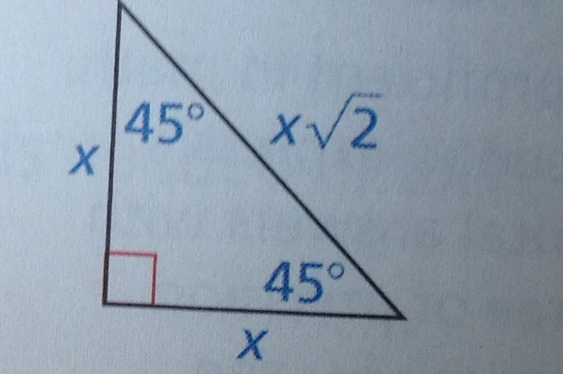
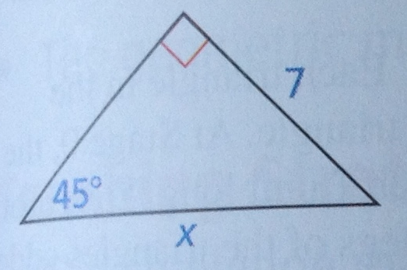
Ex. 1 45-45-90 triangle
Find missing side
You are given short side which is x
X = 7; so hypotenuse is x = $7\sqrt{2}$
Use 45-45-90 triangle thm

Slide 4
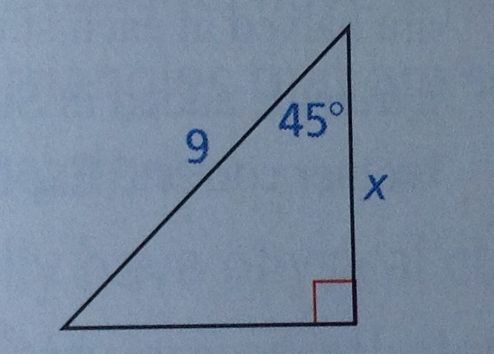
Ex. 1 Continued
Find missing side
You were given hypotenuse which is $x\sqrt{2}$
x$\sqrt{2}=9$
Solve for x
$\frac{x\sqrt{2}}{\sqrt{2}}=\frac{9}{\sqrt{2}}$
Can’t have square root on bottom
$\frac{9}{\sqrt{2}}×\frac{\sqrt{2}}{\sqrt{2}}$
$\frac{9\sqrt{2}}{2}$

Slide 5
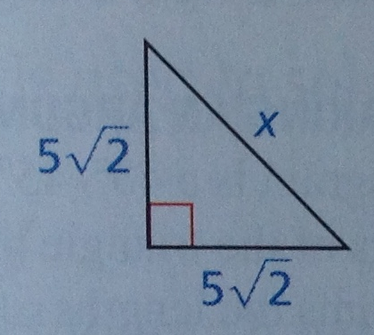
Your practice
Find missing side
$x=5\sqrt{2}$
Hypotenuse is $x×\sqrt{2}$
So $5\sqrt{2}×\sqrt{2}$
$5×2$
10

Slide 6
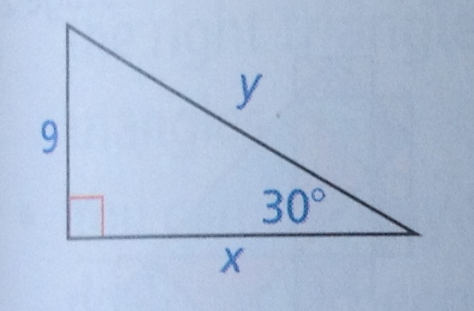
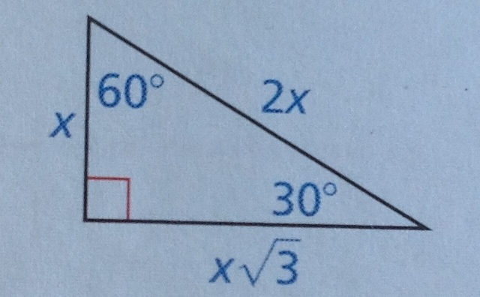
Ex. 2 30-60-90 Triangle
Use 30-60-90 Thm
Find missing sides
Given short side which is x
So x = 9
Long side is $x\sqrt{3}$
So long side is $9\sqrt{3}$
Hypotenuse is 2x
So hypotenuse is $2×9$
18

Slide 7
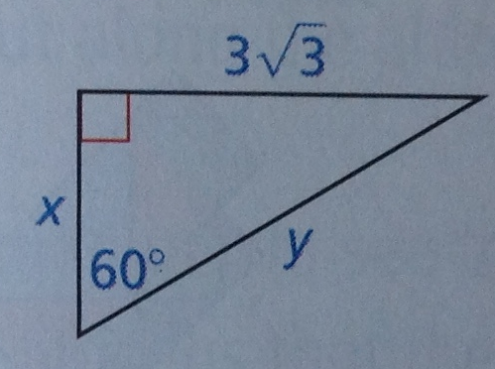
Ex. 2 Continued
Find missing sides
Given long side which is $x\sqrt{3}$
$x\sqrt{3}=3\sqrt{3}$
Solve for x
$\frac{x\sqrt{3}}{\sqrt{3}}=\frac{3\sqrt{3}}{\sqrt{3}}$
$x=3$
So short side is x = 3
Hypotenuse is 2x
2(3)
y = 6

Slide 8
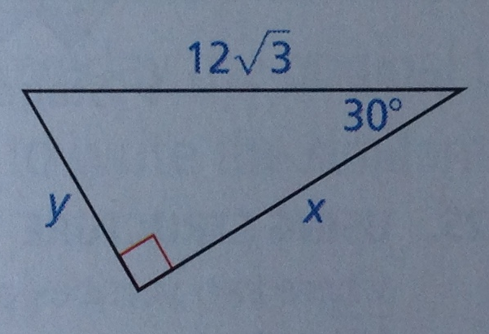
Your Practice
Find missing sides
$2x=12\sqrt{3}$
$\frac{2x}{2}=\frac{12\sqrt{3}}{2}$
$x=6\sqrt{3}$
So $y=6\sqrt{3} which is the short side$
Long side $=x×\sqrt{3}$
$x=6\sqrt{3}×\sqrt{3}$
$x=6×3$
$x=18$

Slide 9
Exs. 3 and 4 story problems
For the 30-60-90
$2x=80$
So x = 40
So ramp is 40 feet high
For 45-45-90
$x\sqrt{2}=80$
$\frac{x\sqrt{2}}{\sqrt{2}}=\frac{80}{\sqrt{2}}$
$\frac{80}{\sqrt{2}}×\frac{\sqrt{2}}{\sqrt{2}}$
$\frac{80\sqrt{2}}{2}$
Ramp is $40\sqrt{2}$ high

